Slide 2
Prototyping!
Dr. Emily Pritchard
inNOLEvation Challenge Workshop
Fall 2021

Slide 3
Design Thinking

Slide 4
human
DESIRABILITY
technical
FEASIBILITY
business
VIABILITY

Slide 5
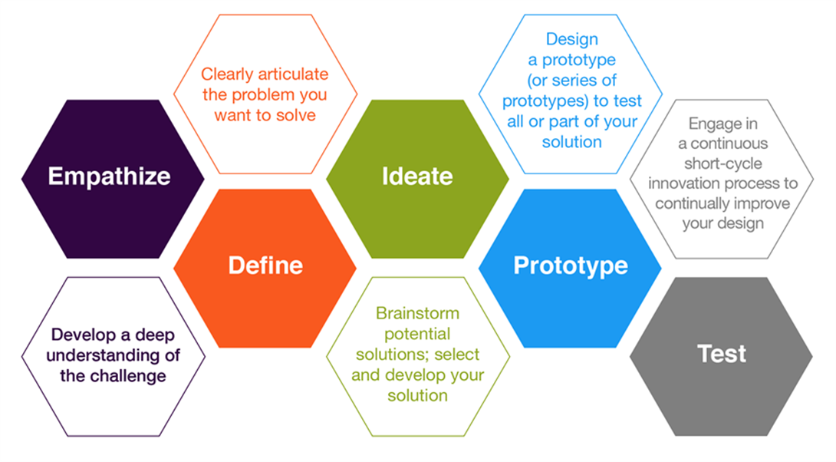

Slide 6
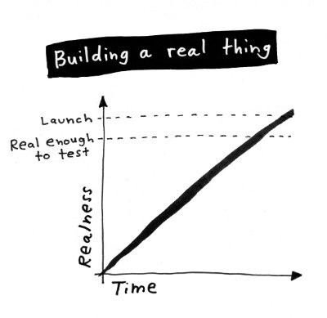
Jake Knapp “Sprint”
https://heleo.com/jake-knapp-jake-knapp-sprint/6499/

Slide 7
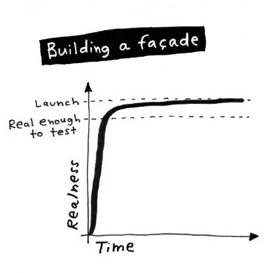
Jake Knapp “Sprint”
https://heleo.com/jake-knapp-jake-knapp-sprint/6499/

Slide 8
Jake Knapp “Sprint”
https://heleo.com/jake-knapp-jake-knapp-sprint/6499/

Slide 9
Jake Knapp “Sprint”
https://heleo.com/jake-knapp-jake-knapp-sprint/6499/

Slide 10
Jake Knapp “Sprint”
https://heleo.com/jake-knapp-jake-knapp-sprint/6499/

Slide 11
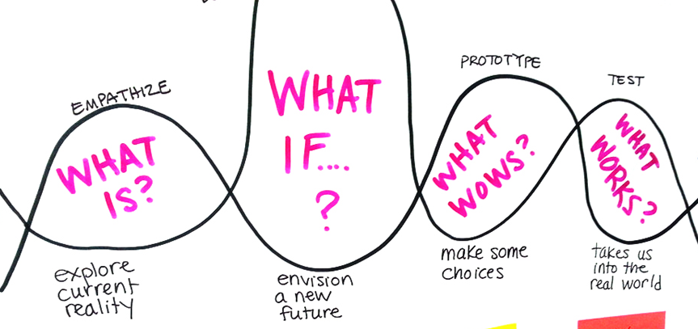
IDEATE
Photo by +Acumen

Slide 12
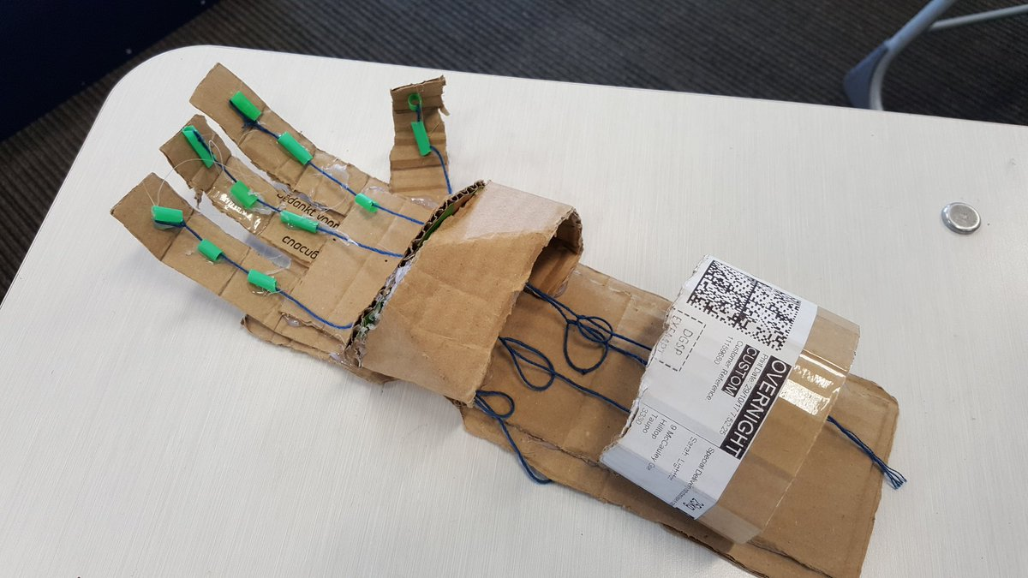
Photo by Stephen Ross

Slide 13
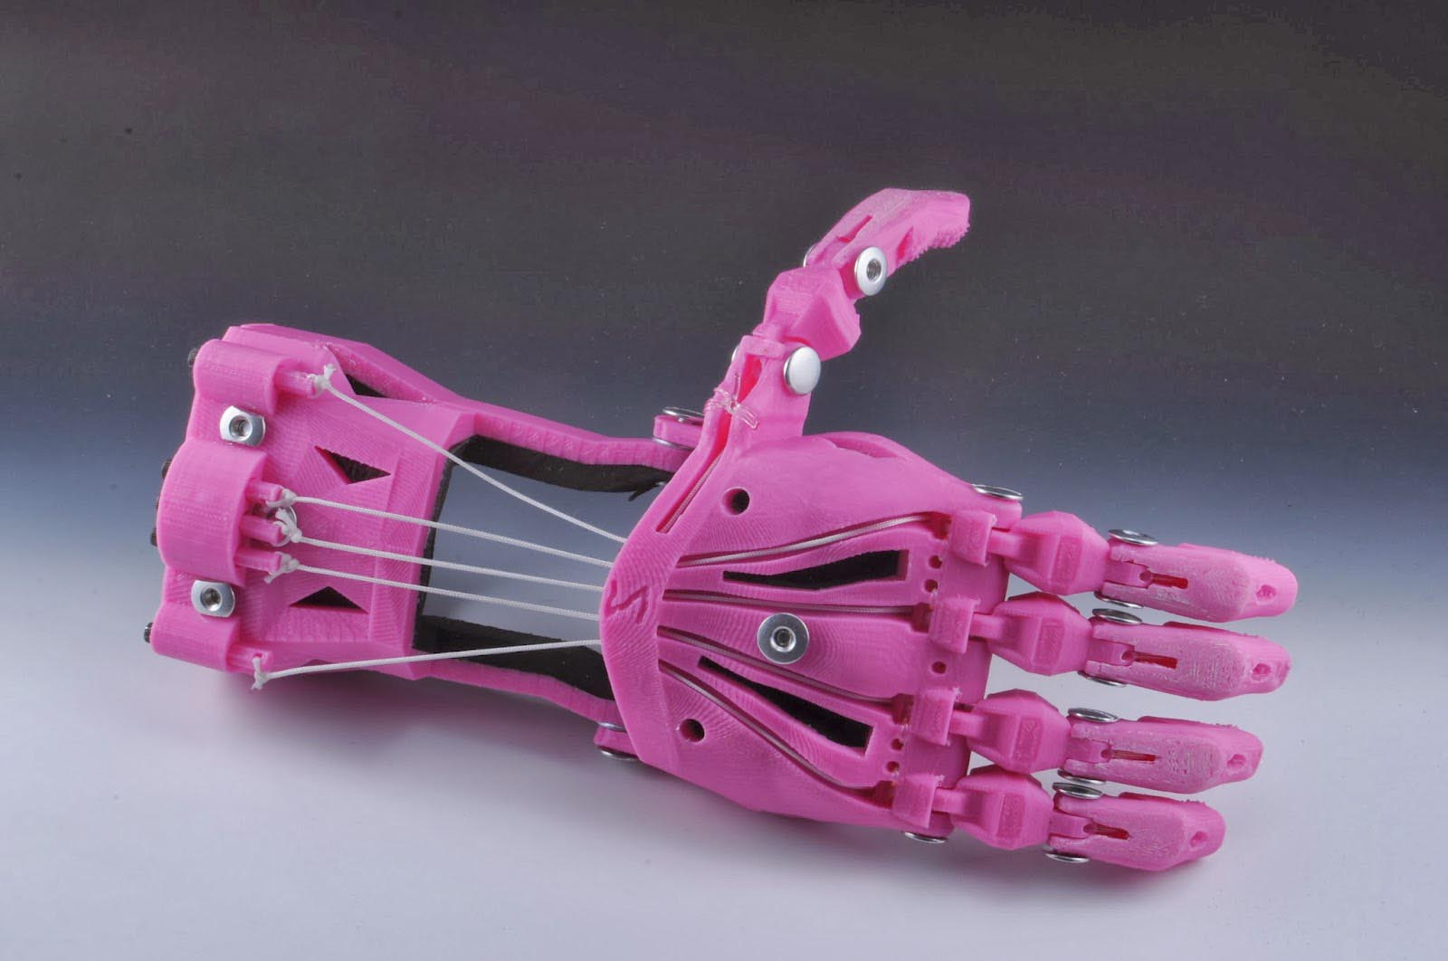
E-Nable Hand

Slide 14
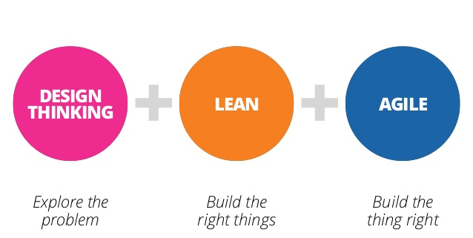

Slide 15
Build a prototype
Pick the right tools
Divide and conquer
Put it together
Do a trial run (or five!)

