Slide 1
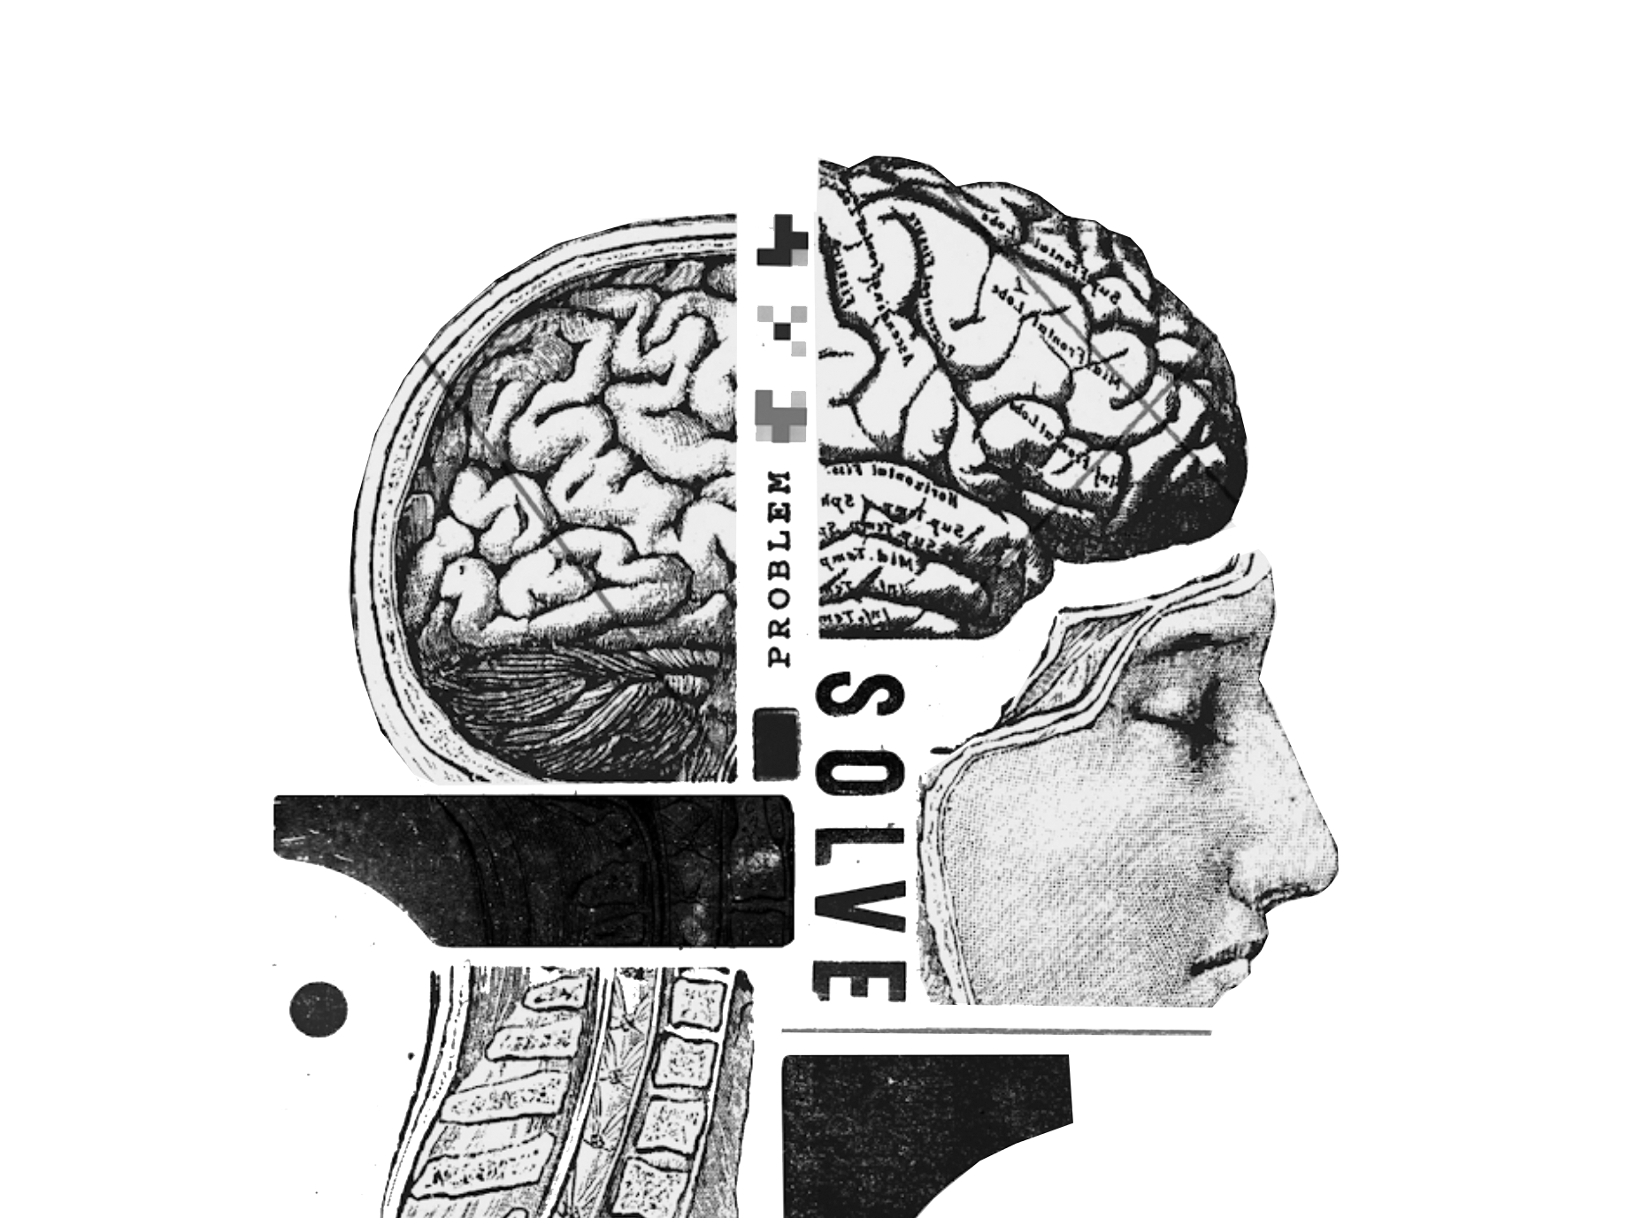
DESIGN
THINKING
by Dr Issy Masduki
FSU Innovation Hub

Slide 2
Play video

Slide 3
Ready for a
Design Challenge?

Slide 4
Design Challenge
Given that many first year college students feel lonely, how might we provide new ways for them to safely connect with new people so that they can become engaged with campus life.

Slide 5
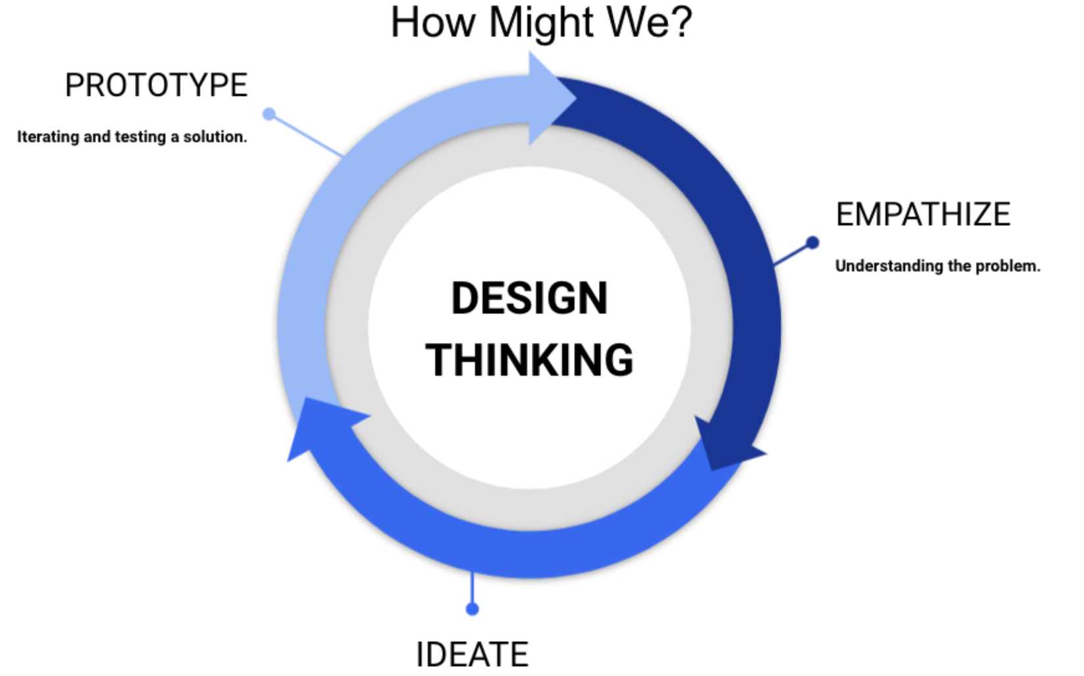

Slide 6
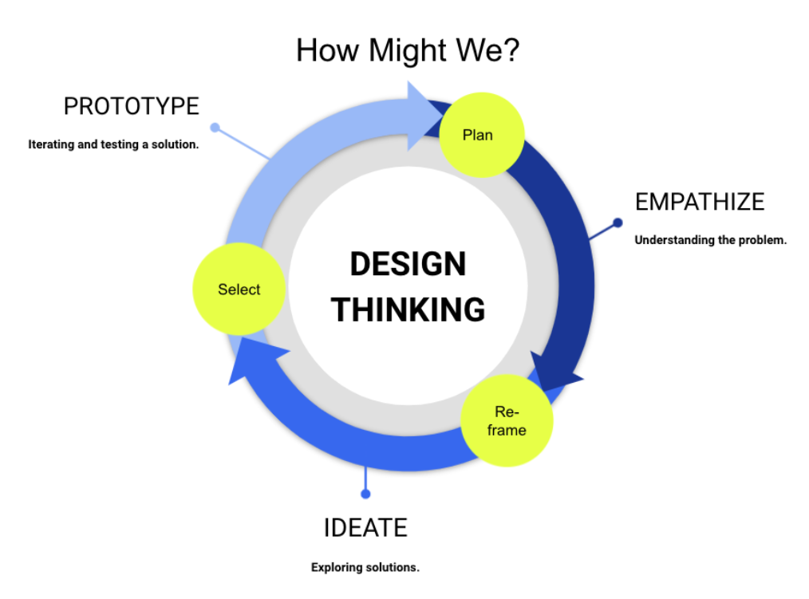

Slide 7
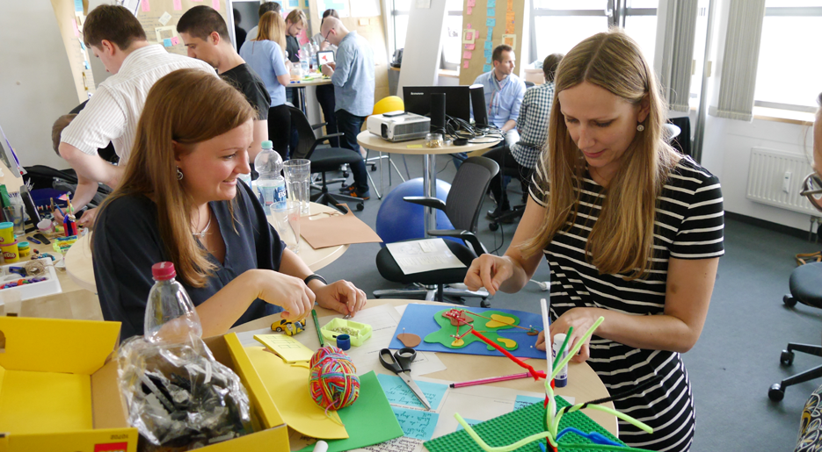
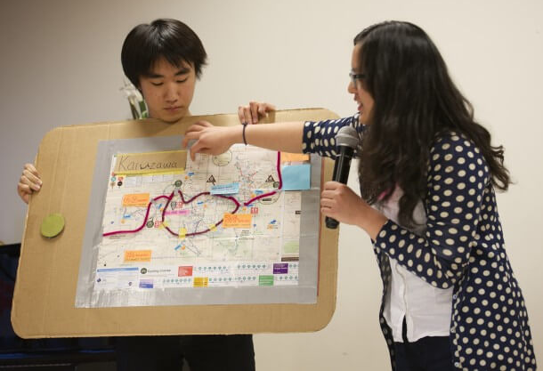
Key Design Thinking Principles
Empathize with people's needs,
Collaborate with others across disciplines, skill sets, and perspectives
Include every idea in visible form for evaluation, and
Repeat, iterating and testing solutions to perfect them, always with human needs at the center.

Slide 8
Empathize
Develop empathy for the end-user
Interview your partner (3 min) Switch roles (3 min) Capture your findings using sticky notes (ONE insight per sticky note)
Tell me what it was like during your first year of college?
How easy or difficult was it to make new friends?
Describe moments/situations when you may have felt lonely.
Describe times when you felt anxious, stressed, or depressed?
What helped you overcome these feelings?

Slide 9
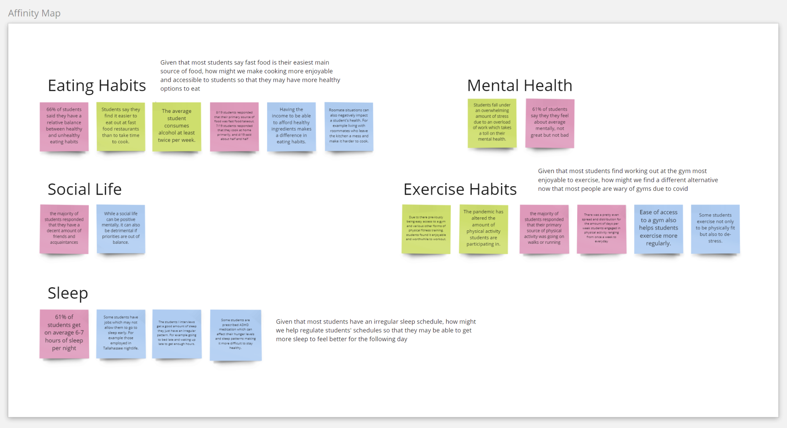
Empathy
In a team of 4 people, combine your data (8 min)
Share your sticky notes with one another
See what common findings (themes) emerge from the sticky notes
Group similar findings together
Label the themes

Slide 11
Reframe the problem
How might we…. (3 min) How might we help _____________________ (target group you want to design for) ____________________________ (do/feel/achieve) so that they can _____________________________ (goal).

Slide 12
Reframe the problem
How might we…. How might we help international students who often faced language and cultural barriers connect better with their peers so that they may become immersed in the American culture.

Slide 13
Reframe the problem
How might we….
How might we help students who don’t enjoy wild parties find meaningful activities and connections on campus so that they can feel like an important part of the FSU community.

Slide 15
Ideate: generate alternatives
Each person writes down 3 - 4 ideas on sticky notes (1 idea per note) (3 min)
Each person present their ideas to the team. The team discusses each idea and decide which idea they like best (4 min)
Idea 1
Idea 2
Idea 3

Slide 17
Build and test
Create a prototype of your solution (10 min)
Some possibilities:
Draw out your solution on large piece of paper
Create a flowchart of computer screens
Storyboard an end user experience of using your solution

Slide 18
Build and test
Share solutions and get feedback (10 min)
What worked?
What could be improved?
Questions from team member?
Ideas from team member?

