Slide 1
2023 - 2024 InNOLEvation® Challenge Information Session

Slide 2
What is it?
A Business Model competition – uses Lean Startup methods and the Business Model Canvas
The main goal is to make this a valuable learning experience for all participants.
Workshops and workshop videos will help you identify and precisely define your assumptions about the new venture, test those assumptions in the field, and then pivot (change) based on what you learned.

Slide 3
Prizes
$10,000: Best Overall Award
$4,000: Jim Moran Challenge Social Venture Award
$4,000: Spirit of Entrepreneurship Award
$4,000: DivvyUp Most Viable Award
$4,000: Most Scalable Award
$4,000: Most Innovative Award
$500 per Finalist, if no award is won

Slide 4
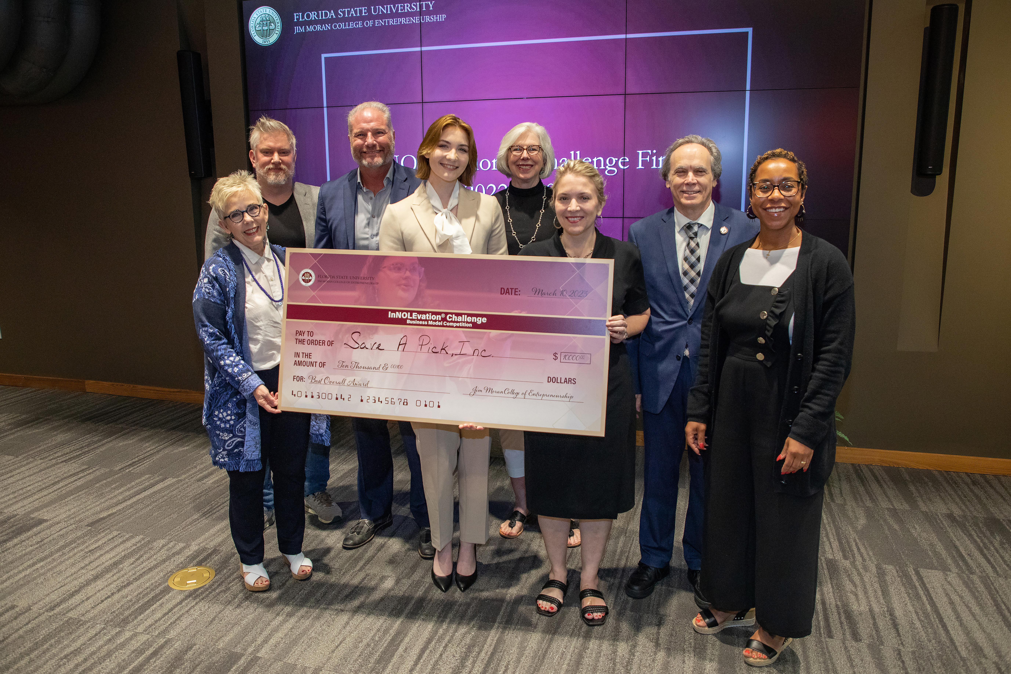
2023 Winner
Save A Pick
$10,000 Prize in 2023

Slide 5
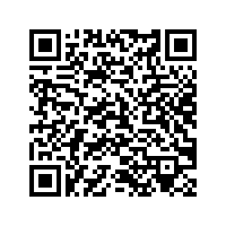
Eligibility Guidelines
Competing teams should have no more than five degree-seeking students enrolled for six credit hours or more at FSU at the time of application (additional team members can be added with approval).
Student team must have a minimum of 51% ownership and voting control in the venture and must have played a major role in creating the venture.
The business model submitted must be original work done by the student team.
The company must not have booked substantial revenue (more than $100,000) prior to September 1, 2023.
See https://icse.jmc.fsu.edu/competitions/innolevation-challenge/guidelines-requirements for more eligibility details.

Slide 6
Business Model Canvas (BMC)

Slide 7
Process: Stage I (Due Jan. 17)
What is the Value Proposition
Develop hypotheses or assumptions:
Who is your customer?
What do they want?
How do they want it?
How will you get it to them?
What will you need to get started?
This submission will include the Business Model Canvas minus the costs and revenue section.
This is also the final opportunity to drop or add team members.
Include names of all team members, the business idea, and company name.
The application will be posted on StartupTree.
Judges will narrow the participants to 15 semi-finalists after this round.

Slide 8
Stage II (Due Feb. 7)
Test your assumptions with potential customers to see if they’re accurate
Reset your hypotheses (pivot)
Go out and test them again. This can continue until you feel that you have a good understanding of your customer.
What value will you deliver?
How will you satisfy that customer?
Summarize all of this testing and pivoting that you have done.
Stage II will be submitted by February 7th. This includes the entire business model canvas.
The semi-finals will take place on February 9th in front of a panel of judges. The finalists will be announced on February 12th.

Slide 9
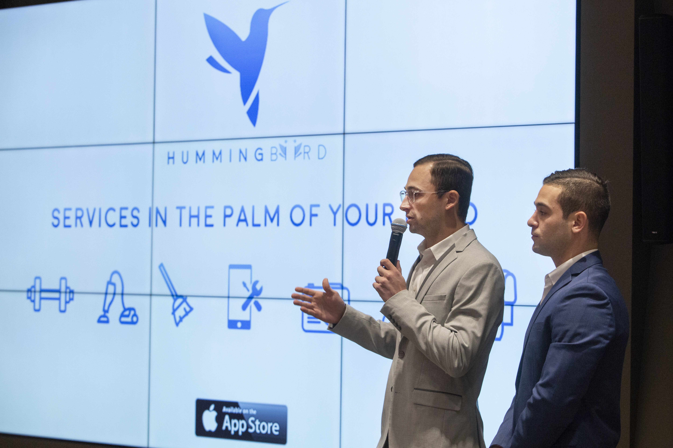
3 Key Steps of Successful Business Model Validation
Identify and track your assumptions with the business model canvas
Test your assumptions in the field with customers and pivot if your model is wrong
Demonstrate that you have gained market traction using feedback from actual customers

Slide 10
Stage III (Due Feb. 23rd)
Prepare and submit a one-page executive summary of the business that will be sent to the judges for the final presentations. Submission three is due February 23rd.
summarizes your entire project from beginning to end.
Present to a panel of judges on March 1st at the Finals where the winners are chosen.

Slide 11
Judging Criteria
Did the team identify a significant problem or unmet need and create a venture to solve this problem?
What is the size of the market and what percentage do you expect to capture?
Has the team developed a prototype or minimum viable product? How far along are you on the product cycle?
Does the team have significant evidence that the solution is validated (includes letters of intent, purchase contracts, sales, and partners)?
How will the prize money help your venture?
For social ventures:
Is addressing the social/environmental problem the primary purpose for the creation of the enterprise? If so, why?
Does it have an innovative, systemic approach to addressing the social/environmental problem? If so, how?
Does the organization have a sustainable approach to achieving its mission and implementing/scaling its innovative approach to addressing the social/environment problem? If so, explain.
If your venture does not address a social/environmental problem as its primary purpose, does it positively impact society in some other manner? If so, how?

Slide 12
Judging Criteria (continued)
Most Innovative Award $4,000
Creativity
Disruptiveness
Ability to solve a problem in new ways
Prototype or MVP developed
Demonstrated differentiation from competitors
Jim Moran Challenge Social Venture Award $4,000
Primary purpose is addressing social/environmental problem
Systemic approach to addressing social/environmental problem
Sustainable approach to achieving its mission
Positively impacts society
Triple Bottom Line
Spirit of Entrepreneurship Award $4,000
Presentation
Passion
Character
Teamwork
DivvyUp Most Viable Award $4,000
Strong first year sales
Proven validation of market
Demonstrated execution ability
Validated and realistic financial model
Demonstrated differentiation from competitors
Most Scalable Award $4,000
Strong five-year sales potential
Actionable plan for growth
Potential for new markets
Potential for outside investment
Probability for greater global expansion
Best Overall Award $10,000
Highest points overall of all criteria added together
Finalist
$500 if no award is won

Slide 13
Forming a Team
It isn’t required, but we recommend students work in teams of at least three people rather than working alone.
Attend workshops to meet people and join a team
Recruit students from across different disciplines to join your team
The best teams all have different majors and interests.
Remember, the deadline to form your team is January 17th so you have plenty of time!

Slide 14
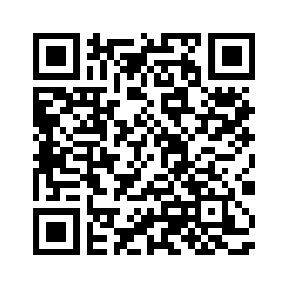
How to Apply
Apply on https://jmc-fsu.startuptree.co/
Deadline to apply: January 17th, 2024 at midnight
Open to current FSU or FAMU/FSU College of Engineering Students ONLY (enrolled for at least six credit hours at the time of application)
Others can be on the team, but FSU Student needs to have at least 51% ownership and control
Check https://icse.jmc.fsu.edu/competitions/innolevation-challenge for the latest announcements and updates about the InNOLEvation® Challenge

Slide 15
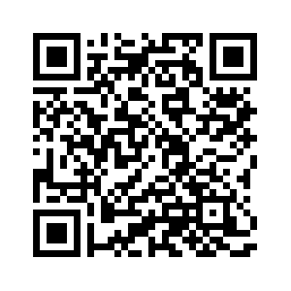
Important Dates
September
20th & 21st – Workshop 1 – Intro.
26 – Workshop 2 – Business Model Canvas
October
2nd – Workshop 3 – Design Thinking
11th – Workshop 4 – Customer Discovery
16th – Workshop 5 – Triple Bottom Line*
25th – Workshop 6 – Emerging Technologies, Web Development
November
1st – Workshop 7 – Prototyping & Visualizing Your Product/Service
8th – Workshop 8 – Building & Marketing Your Brand
28th – Workshop 9 – Business Finance
January
17th – Application Due
26th – Announcement of 15 teams advancing
29 or 30 – Workshop 10 – Effective Pitches/Presentations
February
7th – Stage II Due
9th – Semi-Finals
12th – Announcement of teams advancing
23rd – Stage III Due
March
1st – InNOLEvation® Challenge Finals
https://icse.jmc.fsu.edu/competitions/innolevation-challenge/timeline

Slide 16
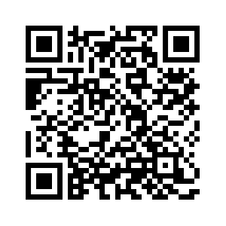
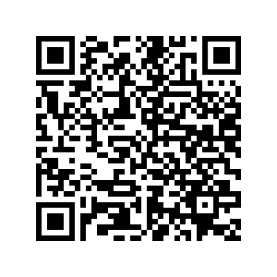
Resources Available on the Website
InNOLEvation® Challenge Resources
https://tinyurl.com/jmcic24stage1

Slide 17
If you have questions or need help
Kaitlin Simpson
ksimpson@jmc.fsu.edu
850-644-1691
Morgan Rodgers
mrodgers@jmc.fsu.edu
850-645-1771

