Slide 1
Business Model Canvas

Slide 2
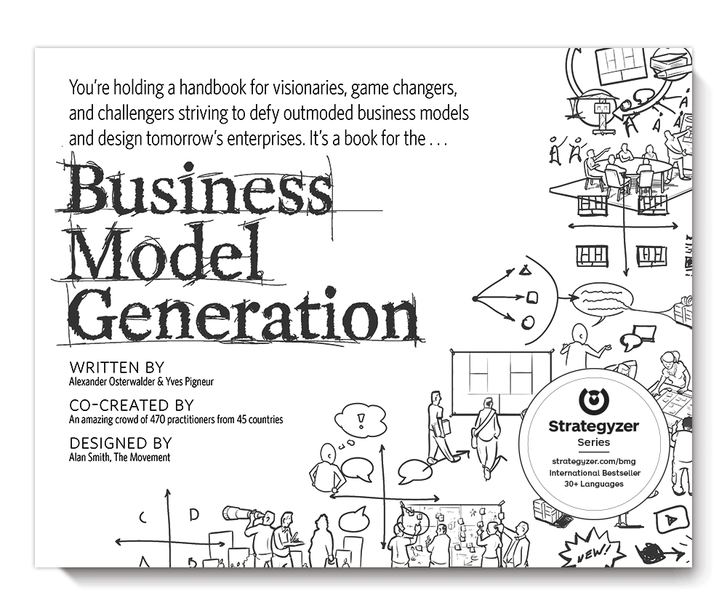

Slide 3
Customer Relationships
Key Activities
Revenue Streams
Cost Structure
Value Propositions
Channels
Key Resources
Customer Segments
Key Partners

Slide 4
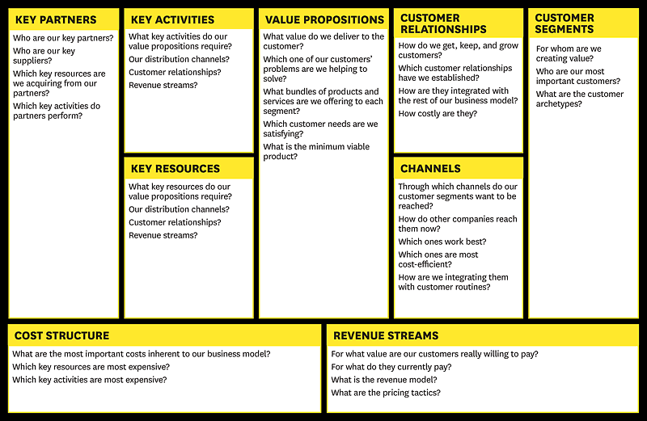
Business Model Canvas (BMC)

Slide 5
Customer Segments
Value Propositions
Channels
Customer Relationships
Revenue Streams
Key Resources
Key Activities
Key Partners
Cost Structure
Create and Generate Value
Generate Efficiencies to Deliver Value

Slide 6
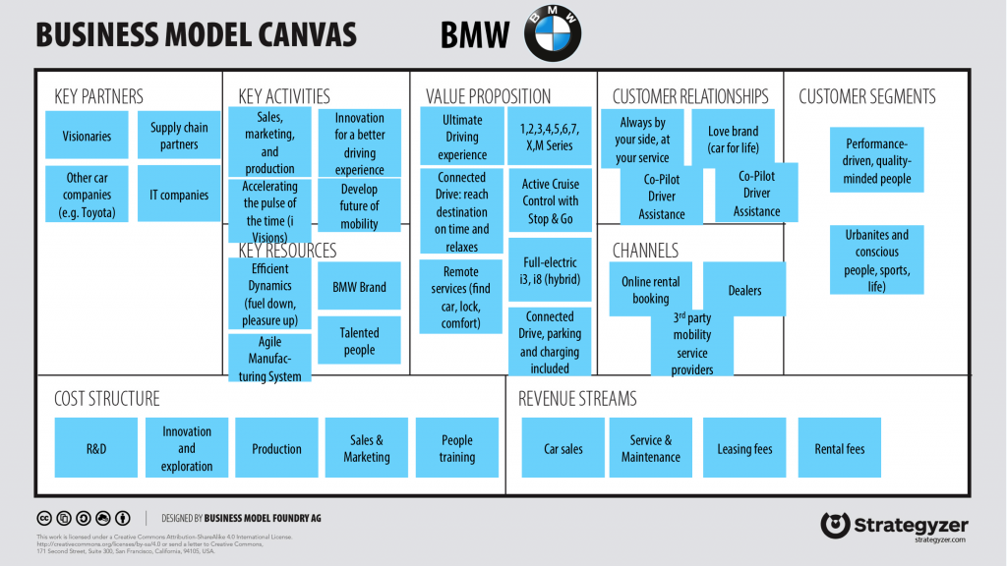
BMC Explained
https://vimeo.com/78350794

Slide 7
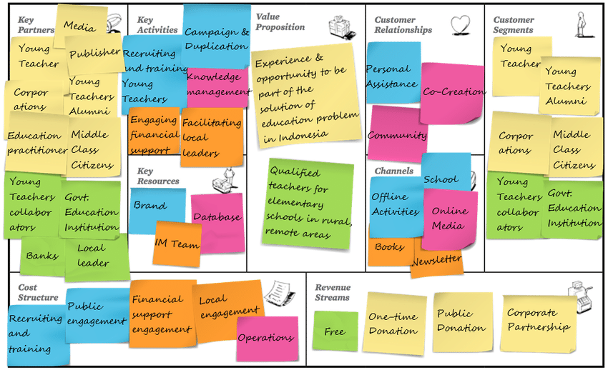
3 Key Steps of Successful Business Model Validation
Identify and track your assumptions with the business model canvas
Test your assumptions in the field with customers and pivot if your model is wrong
Demonstrate that you have gained market validation using feedback from actual customers

Slide 8
Link to BMC Template

Slide 9
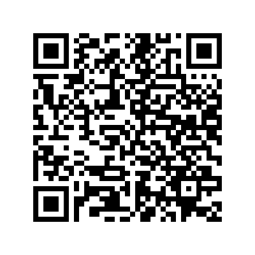
Apply using the QR code below!

