Slide 1
2021 - 2022 InNOLEvation™ Challenge Information Session

Slide 2
What is it?
A Business Model competition – uses Lean Startup methods and the Business Model Canvas
The main goal is to make this a valuable learning experience for all participants.
Workshops will help you identify and precisely define your assumptions about the new venture, test those assumptions in the field, and then pivot (change) based on what you learned.

Slide 3
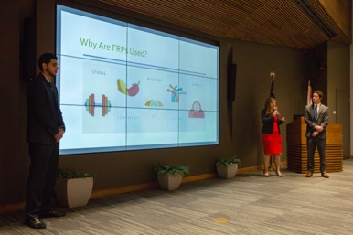
Prizes
$10,000 Best Overall
$4,000 Strongest social/environmental impact (Jim Moran Challenge Social Venture award)
$4,000 Spirit of Entrepreneurship
$4,000 Most Viable
$4,000 Most Scalable
$4,000 Most Innovative
$500 per Finalist, if no award is won

Slide 4
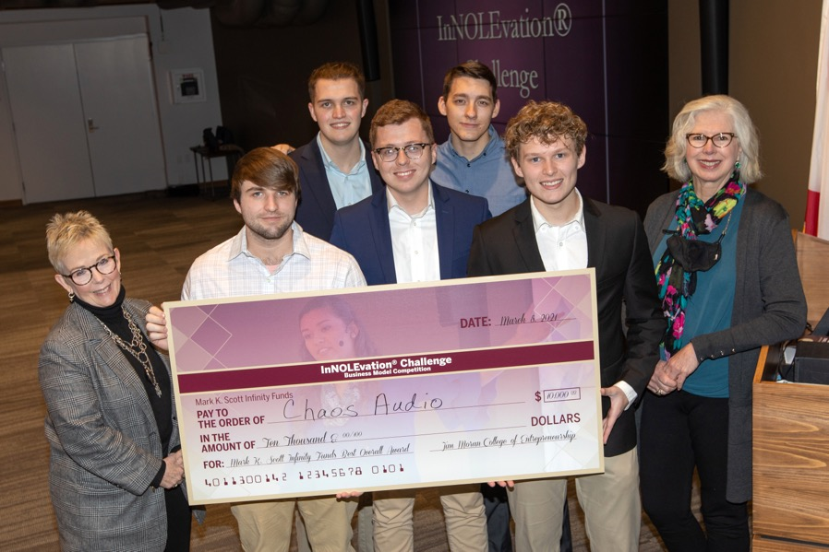
2021 Winner
Chaos Audio
$10,000 Prize in 2021

Slide 5
Eligibility Guidelines
Competing teams should have no more than five degree-seeking students enrolled for six credit hours or more at FSU at the time of application (additional team members can be added with approval).
Student team must have a minimum of 51% ownership and voting control in the venture and must have played a major role in creating the venture.
The business model submitted must be original work done by the student team.
The company must not have booked substantial revenue (more than $100,000) prior to September 1, 2021.
See https://jimmorancollege.fsu.edu/student-engagement/innolevation-challenge/guidelines-and-requirements/ for more eligibility details.

Slide 6
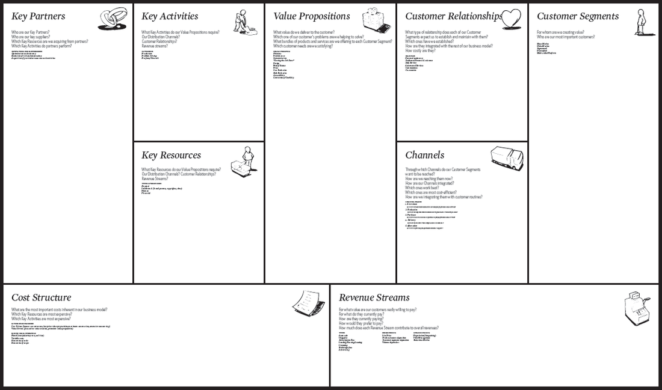
Business Model Canvas (BMC)

Slide 7
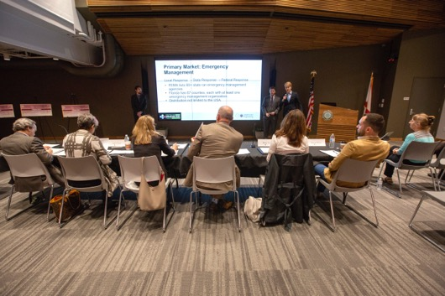
Process: Stage I (Due Nov. 5)
Develop a value proposition:
What value you will deliver to a customer?
What is the problem you are trying to solve?
What is the need you are filling?
The value proposition will be summarized and submitted in Stage I by November 5th. Include names of all team members, the business idea, and company name. Revisions are allowed in future submissions.
https://jmc-ic-fsu.smapply.us/prog/innolevation_challenge_2021_-_2022/

Slide 8
Process: Stage II (Due Jan. 10)
Develop hypotheses or assumptions:
Who is your customer?
What do they want?
How do they want it?
How you will get it to them?
What you will need to get started?
These hypotheses will be submitted in Stage II by January 10th. This submission will include the Business Model Canvas minus the costs and revenue section. This is also the final opportunity to drop or add team members.
Judges will narrow the participants to 15 semi-finalists after this round.

Slide 9
Stage III (Due Feb. 1)
Test your assumptions with potential customers to see if they’re accurate
Reset your hypotheses (pivot)
Go out and test them again. This can continue until you feel that you have a good understanding of your customer
What value will you deliver?
How will you satisfy that customer?
Summarize all of this testing and pivoting that you have done, reworking the Stage II sections of the Business Model Canvas
Stage III will be submitted by February 1st. This includes the entire business model canvas.
The semi-finals will take place on February 4th in front of a panel of judges. The finalists will be announced on February 7th.

Slide 10
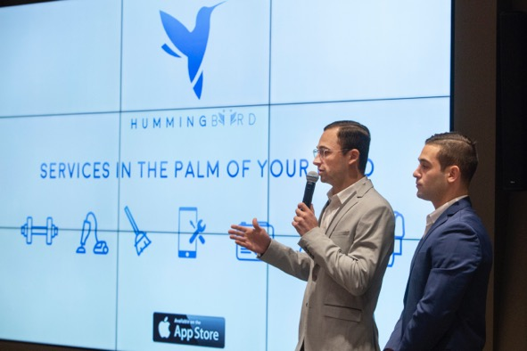
3 Key Steps of Successful Business Model Validation
Identify and track your assumptions with the business model canvas
Test your assumptions in the field with customers and pivot if your model is wrong
Demonstrate that you have gained market traction using feedback from actual customers

Slide 11
Stage IV (Due Feb. 28th)
Prepare and submit a one-page executive summary of the business that will be sent to the judges for the final presentations. Submission four is due February 28th.
summarizes your entire project from beginning to end.
Present to a panel of judges on March 4th at the Finals where the winners are chosen.

Slide 12
Judging Criteria
Did the team identify a significant problem or unmet need and create a venture to solve this problem?
What is the size of the market and what percentage do you expect to capture?
Has the team developed a prototype or minimum viable product? How far along are you on the product cycle?
Does the team have significant evidence that the solution is validated (includes letters of intent, purchase contracts, sales, and partners)?
How will the prize money help your venture?
For social ventures:
Is addressing the social/environmental problem the primary purpose for the creation of the enterprise? If so, why?
Does it have an innovative, systemic approach to addressing the social/environmental problem? If so, how?
Does the organization have a sustainable approach to achieving its mission and implementing/scaling its innovative approach to addressing the social/environment problem? If so, explain.
If your venture does not address a social/environmental problem as its primary purpose, does it positively impact society in some other manner? If so, how?

Slide 13
Judging Criteria (continued)
Most innovative $4,000
Creativity
Disruptiveness
Ability to solve a problem in new ways
Prototype or MVP developed
Demonstrated differentiation from competitors
Strongest social/environmental impact (Jim Moran Challenge Social Venture award) $4,000
Primary purpose is addressing social/environmental problem
Systemic approach to addressing social/environmental problem
Sustainable approach to achieving its mission
Positively impacts society
Triple Bottom Line
Spirit of Entrepreneurship $4,000
Presentation
Passion
Character
Teamwork
Participation (point for every workshop)
Most Viable $4,000
Strong first year sales
Proven validation of market
Demonstrated execution ability
Validated and realistic financial model
Demonstrated differentiation from competitors
Most Scalable $4,000
Strong five-year sales
Actionable plan for growth
Potential for new markets
Potential for outside investment
Probability for greater global expansion
Best Overall –$10,000
Highest points overall of all criteria added together
Finalist
$500 if no award is won

Slide 14
Forming a Team
It isn’t required, but we recommend students work in teams of at least three people rather than working alone.
Attend workshops to meet people and join a team
Recruit students from across different disciplines to join your team
The best teams all have different majors and interests.
Remember, the deadline to form your team is January 10th so you have plenty of time!

Slide 15
How to Apply
Sign in with your FSU ID – https://jmc-ic-fsu.smapply.us/prog/innolevation_challenge_2021_-_2022/
Deadline to apply: November 5th, 2021 at midnight
Open to current FSU or FAMU/FSU College of Engineering Students ONLY (enrolled for at least six credit hours at the time of application)
Others can be on the team, but FSU Student needs to have at least 51% ownership and control
Check https://jimmorancollege.fsu.edu/student-engagement/innolevation-challenge/ for the latest announcements and updates about the InNOLEvation ™ Challenge

Slide 16
Important Dates
September
15th & 16th – Workshop – Intro.
21st – Workshop – Design Thinking
28th – Workshop – Identifying Needs
October
5th – Workshop – Market Research
13th – Workshop – Triple Bottom Line
14th – Exploratory Session NASA T2U*
19th – Workshop – Ent. Toolbox
27th – Workshop - Prototyping
November
3rd – Marketing Your Brand
5th – Application Deadline
17th – Workshop – Finance
30th – Workshop – Machine Learning
January
10th – Stage II Due
14th – Announcement of 15 teams advancing
26th – Workshop – Pitches/Presentations
February
1st – Stage III Due
4th – Semi-Finals
7th – Announcement of teams advancing
28th – Stage IV Due
March
4th – InNOLEvation ™ Challenge Finals
* NASA T2U – 11:30 AM – 2 PM , Exploratory Session in the Innovation Hub Pitch Room
https://jimmorancollege.fsu.edu/student-engagement/innolevation-challenge/timeline/

Slide 17
Resources Available on the Website
InNOLEvation (R) Challenge Resources
Application Link
https://jmc-ic-fsu.smapply.us/prog/innolevation_challenge_2021_-_2022/

Slide 18
If you have questions or need help
Contact Wendy Plant
wplant@jmc.fsu.edu
850-645-2711
Or Kaitlin Simpson
ksimpson@jmc.fsu.edu
850-644-1691

