Slide 1
InNOLEvation Challenge Workshop
Building & Marketing Your Brand
Lanny Lewis
Teaching Faculty, Entrepreneur in Residence
llewis@jmc.fsu.edu

Slide 2
Who will buy (TARGET MARKET)? Why?
Picture your Brand
Name. Draft. Protect.
Effective messaging. Best path forward

Slide 3
Who is your Target Market?
Don’t define too board just to feel good about the potential
Identify the particular market segments you wish to reach
  Distinct, meaningful components of the overall market that give you a set of specific characteristics to identify them
Definable
Meaningful
Sizable
Reachable
Primary market or “first customer” – the customer that needs the product or service the most - customer in the most pain
Entrepreneurs have limited resources – so you need to target the customers with real problems or biggest needs first.

Slide 4
How will you define them?
Consumer level:
  Age Range
  Income Range
  Gender
  Occupation
  Marital Status
  Family Size
  Ethnic Group
  Level of Education
  Home Ownership
Consumer level:
  Family Stage
  Vacation Choices
  Television Shows Watched
  Favorite Websites
  Hobbies / Sports / Other Forms of Entertainment
  Publication Subscriptions
  Political Affiliations
  Type of Car Owned
How Important is…
  Price
  Quality
  Brand Name
  Product Features
  Salesperson
  Sales/Specials Offers
  Advertising
  Packaging
  Convenience of Use
  Convenience of Purchase
  Location
  Store Décor
  Customer Service
  Return Policy
  Credit Availability
  Maintenance Program
  Warranty
How do they spend their time?
What issues are they facing in their lives?
Who do they associate with?
How do they relate to their employees or community?
You have some sense of what they are interested in.
Observe customers in places where they shop or live.
That other products do they buy?
What kind of cars do they drive?
What kind of cloths do they wear?
  Reason / occasion for first purchase
  Number of times they’ll purchase
  Interval between purchases
  Amount of product/service purchased
  Motivation for continued use
  How long to make decision to purchase
  Where customer first learned about product/service
  Place where customer purchases product/service
  Where customer uses product
  How customer uses product
  Method of payment
  Special needs
  Area Served
    City
    Region
    Nation
  Density
    Urban
    Suburban
    Rural
  Nature of the Location
    Mall
    Strip Center
    Business District
  Climate Conditions
Do they go to movies, watch TV, or stream videos?
Do they entertain at home? For whom?
What other products are being used with yours?

Slide 5
Value proposition - set of benefits or values it promises to deliver to consumers to satisfy their needs (why they buy from you)
Why buy from you?

Slide 6
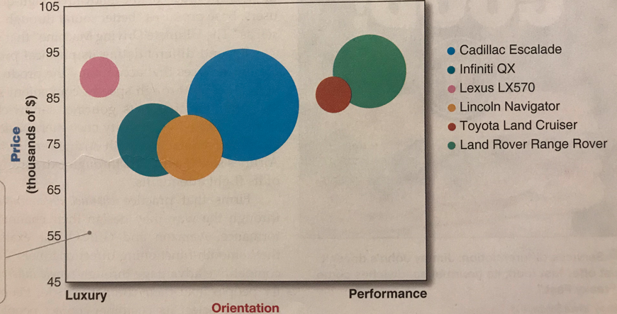
Product positioning – The way a product is defined by consumers on important attributes – the place it occupies in consumers’ minds relative to competing products.
Competitive advantage – advantage over competitors gained by offering greater customer value either by having lower prices or providing more benefits that justify higher prices.

Slide 7
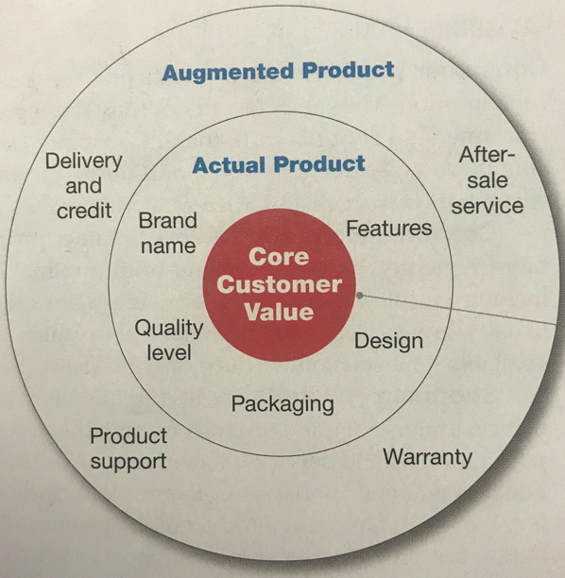
Core Customer value – What is the buyer really buying? – must define the core, problem-solving benefits or services that consumers seek.

Slide 8
Idea screening – Screening new product ideas to spot good ones and drop poor ones as soon as possible. First idea-reducing stage;
Proposed product/service, proposed customer value proposition, target market, and the competition, rough estimates of market size, product price, development time and costs, manufacturing costs, and rate of return.
Asks three questions – need to answer YES to all (R-W-W)
Is it real? (real need, desire for product, will customers buy, will product satisfy the market)
Can we win? Does the product offer a sustainable competitive advantage, do we have the resources to make it a success.
Is it worth doing? Does it fit in our company’s growth strategy? Does it offer sufficient profit potential?
“Real, win, worth doing”

Slide 9
Picture your brand? Mood Board.
A group of pictures, words, products that represent what you like, how you feel, how you want to be viewed.

Slide 10
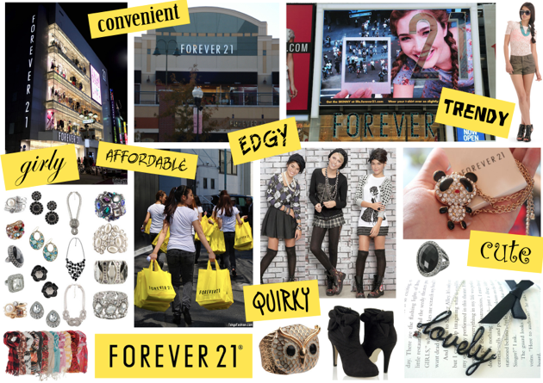

Slide 11
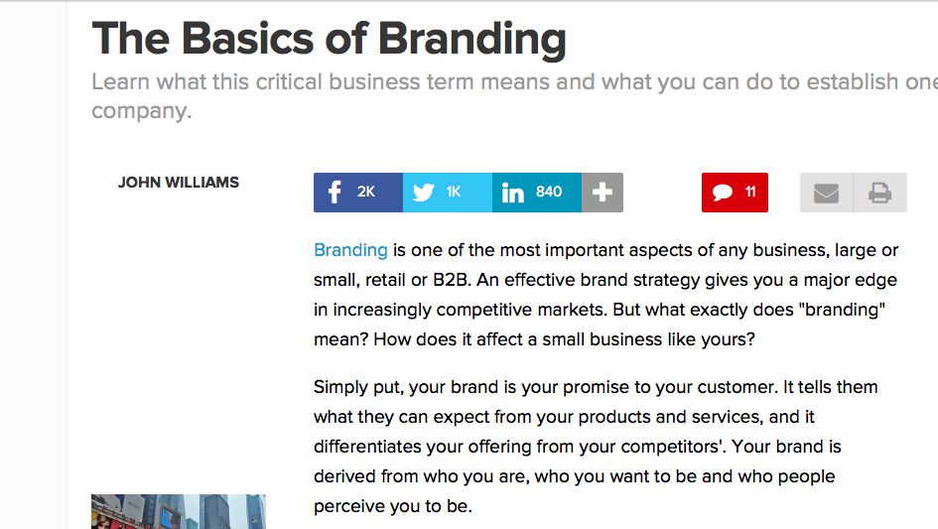
Just a name, right?

Slide 12
Naming Considerations
easy to say and spell
memorable
extendable, has room for growth
positive feeling
international; doesn’t have bad meanings in other languages
available; from trademark and domain perspective
meaning, has relevance to your business

Slide 13
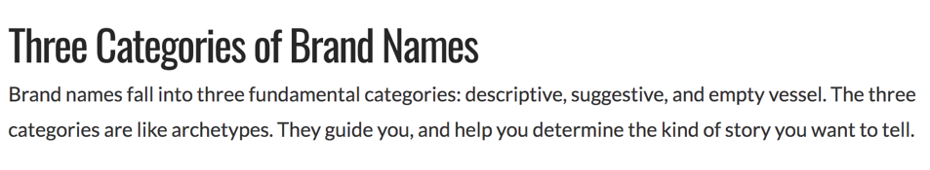
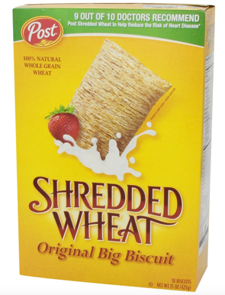
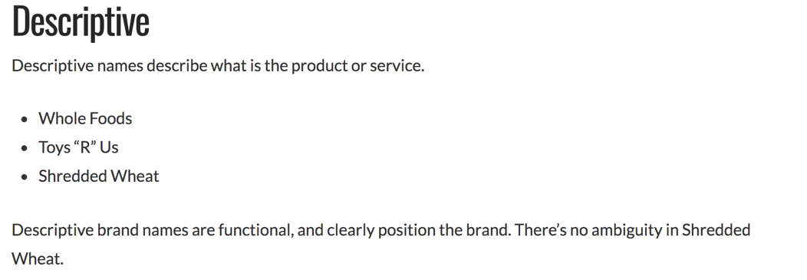

Slide 14
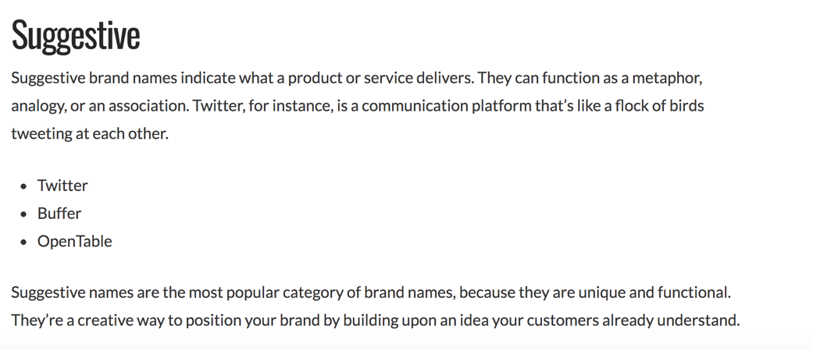


Slide 15
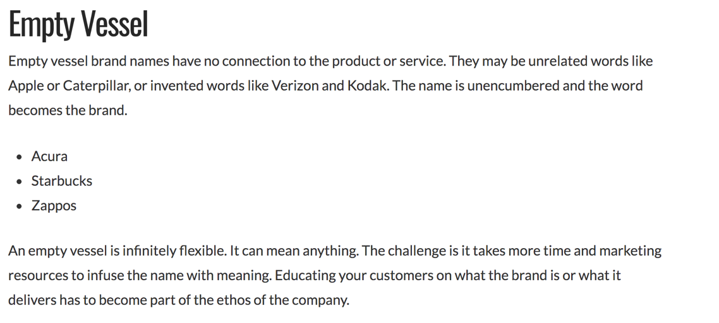


Slide 16
Types of Brand Names
Generic
Milk
Cars.com
Hotels.com
Descriptive
All Bran Cereal
FlatRate Moving
Slim-fast
Band Aid
Suggestive
Greyhound
Amazon
Arbitrary
Shell
Apple
Fanciful
Xerox
Kodak
Less effort to explain brand $
More effort to explain brand $$$
Descriptive Brand Names – are brand names that relate directly to or describe the product or benefit or are derived from a founder’s name.
Examples include General Motors, British Petroleum (BP), The Body Shop, Disney.
http://nancyfriedman.typepad.com/away_with_words/2013/10/the-five-types-of-names-or-why-suggestive-beats-descriptive.html

Slide 17

Types of Brand Names
Generic
Milk
Cars.com
Hotels.com
Descriptive
All Bran Cereal
FlatRate Moving
Slim-fast
Band Aid
Suggestive
Greyhound
Amazon
Arbitrary
Shell
Apple
Fanciful
Xerox
Kodak
Less effort to explain brand $
More effort to explain brand $$$
Descriptive Brand Names – are brand names that relate directly to or describe the product or benefit or are derived from a founder’s name.
Examples include General Motors, British Petroleum (BP), The Body Shop, Disney.
http://nancyfriedman.typepad.com/away_with_words/2013/10/the-five-types-of-names-or-why-suggestive-beats-descriptive.html

Slide 18
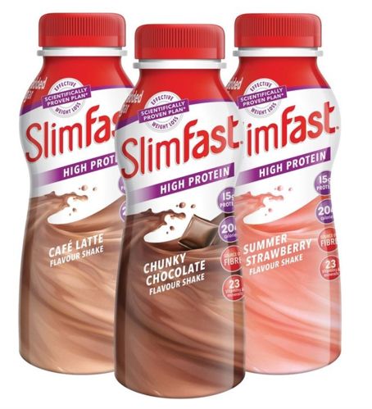
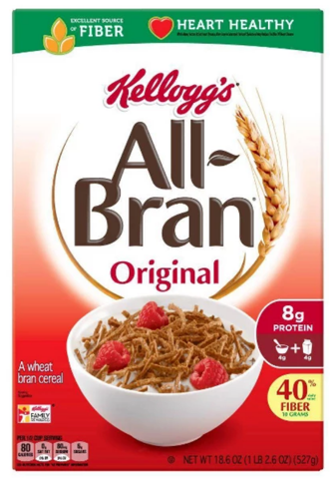

Descriptive

Slide 19
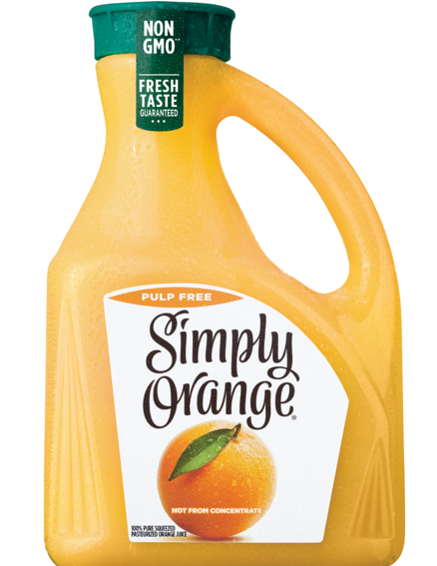
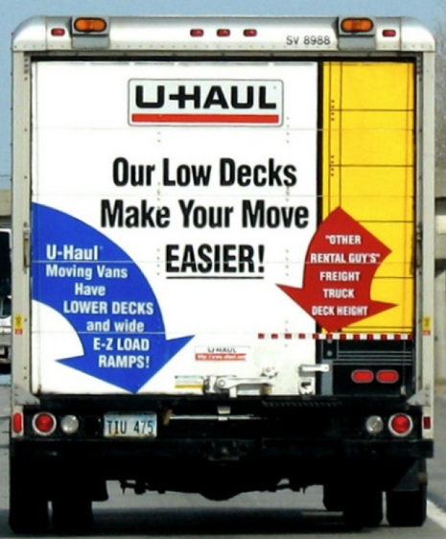
Descriptive

Slide 20
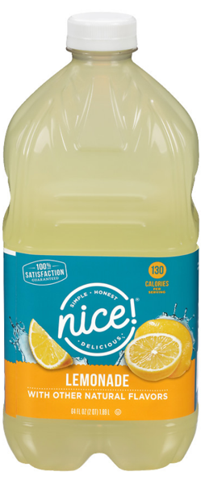
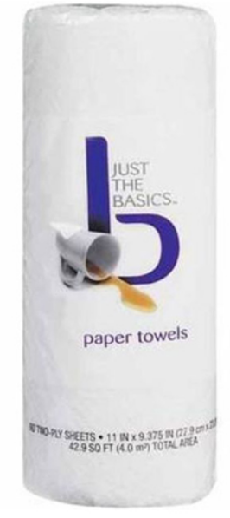

Suggestive

Slide 21
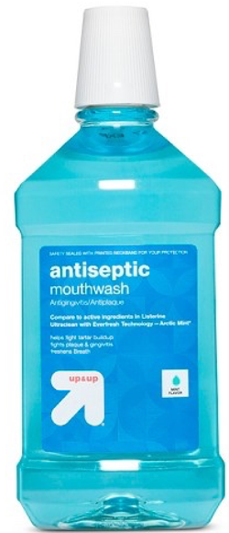

Suggestive

Slide 22
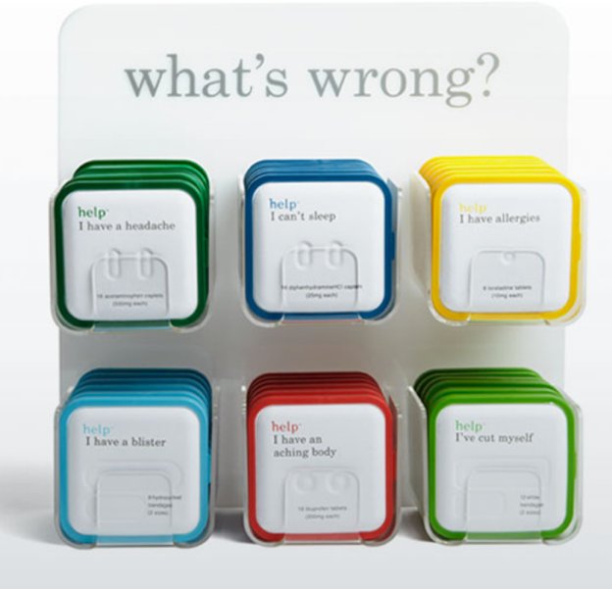
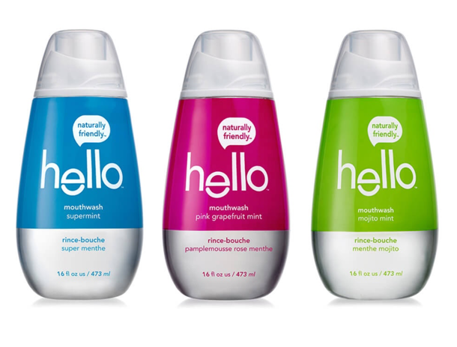
Suggestive

Slide 23

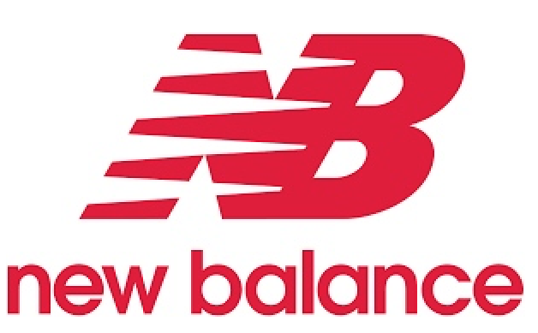
Suggestive

Slide 24
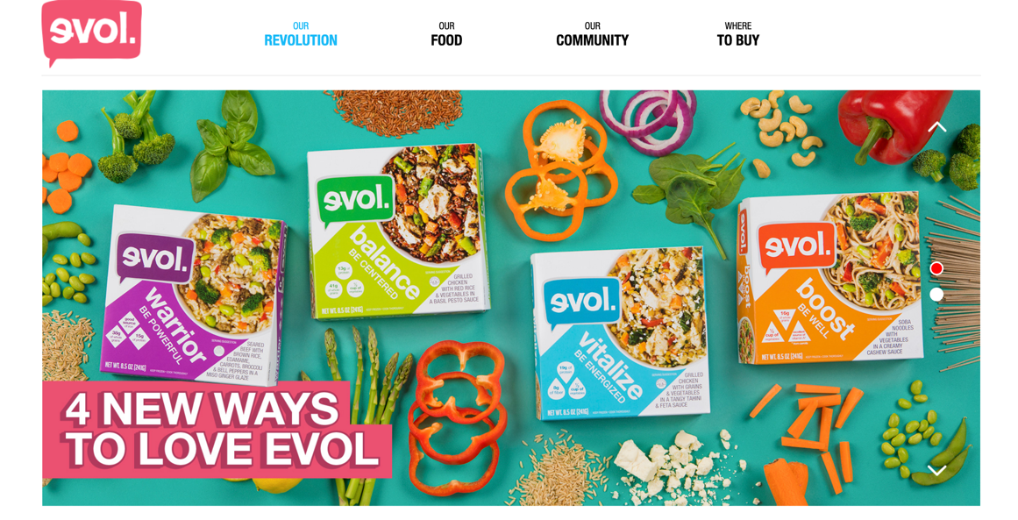
Suggestive

Slide 25
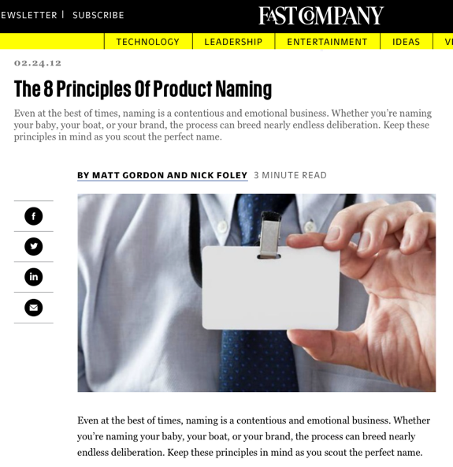
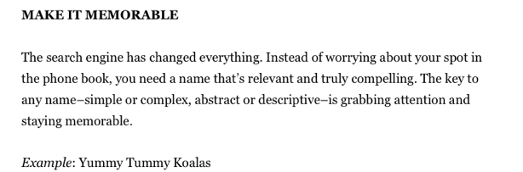

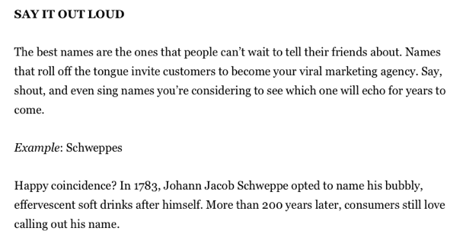

Slide 26
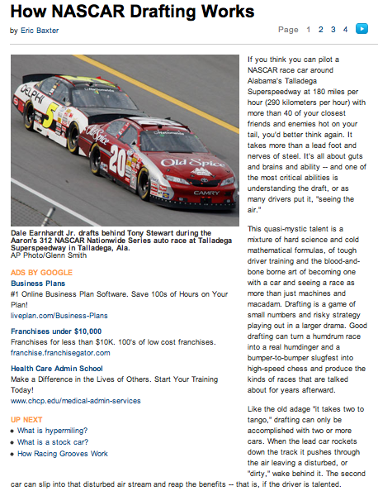
What is Drafting?

Slide 27
What is Brand Drafting?
Allows you to gain traction with consumers with similarities from established brands / products
Color
Name
Packaging type
Flavor
Purpose

Slide 28
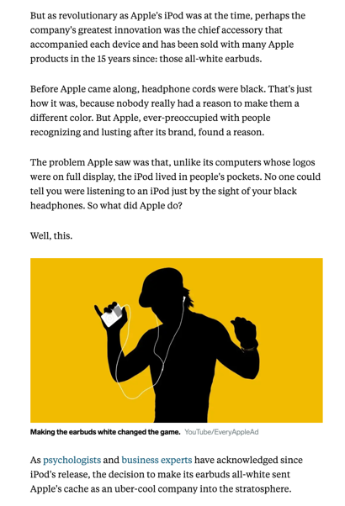
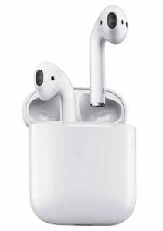
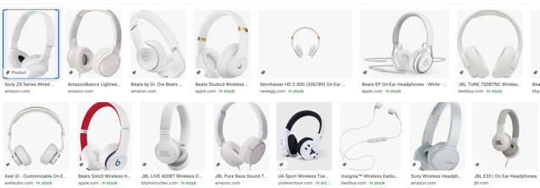
Drafting in Color

Slide 29


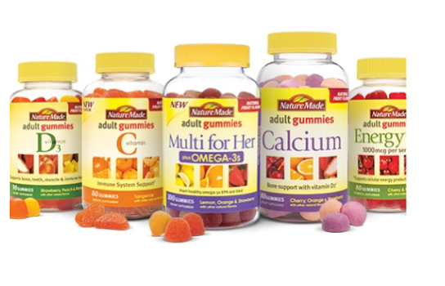
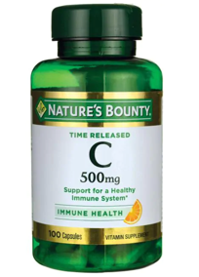
Drafting in Name
1971 – New York
1971 – California

Slide 30
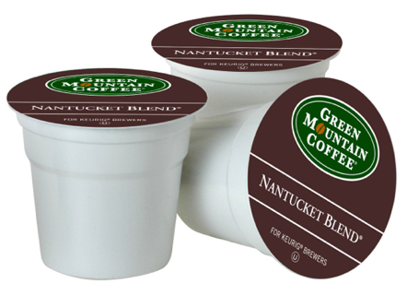
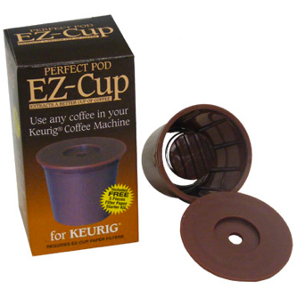
Drafting in Package Type

Slide 31
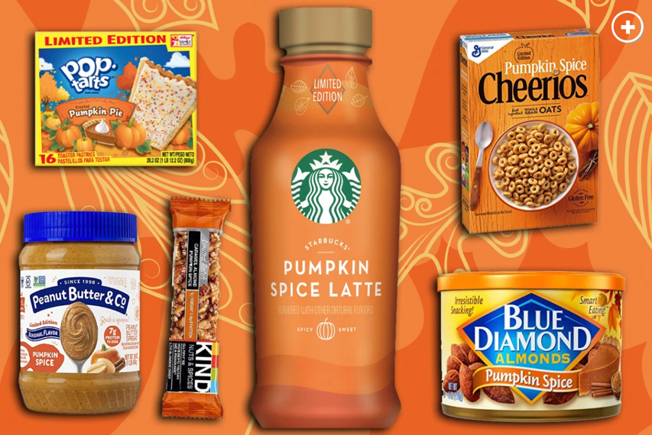
Drafting in Flavor

Slide 32
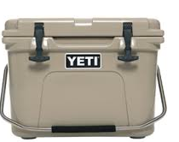

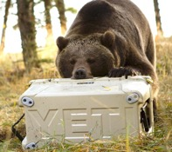
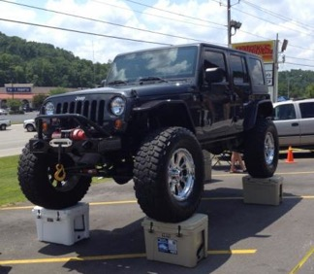
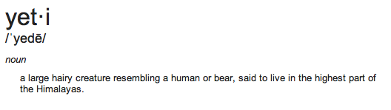
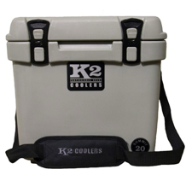
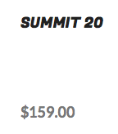

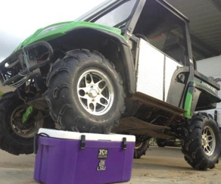
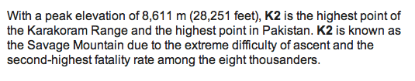
Drafting in Purpose
Founded in 2006
Now $199

Slide 33
Figure 7.2
The Intellectual Property Pyramid
Degree of Protection
Patents
Trademarks
Trade Secrets
Copyrights
If a product is a unique device, a novel process or service, or other type of proprietary item, it may qualify for intellectual property rights. An intangible asset (no physical form)
Can be bought, sold, donated, licensed, or exchanged for something of equal value.
Must understand your IP rights so you can protect them or avoid infringing on the rights of others.

Slide 34
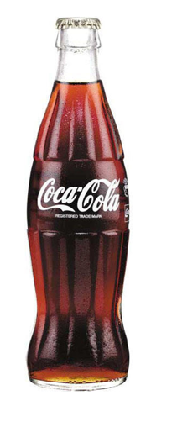

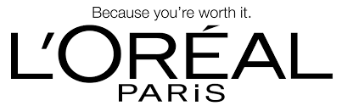
Trademarks
A symbol, logo, word, sound, color, design, or other device that is used to identify a business or a product in commerce
Logo
Slogan:
Container shape:

Slide 35
Trademarks
Items that cannot be trademarked
  Anything immoral or deceptive
  Anything that uses official symbols of the United States or any state or municipality, such as a flag
  Anything that uses a person’s name or likeness without permission

Slide 36



  Identical marks can exist is there is no relationships between the types of goods or services being offered

Slide 37
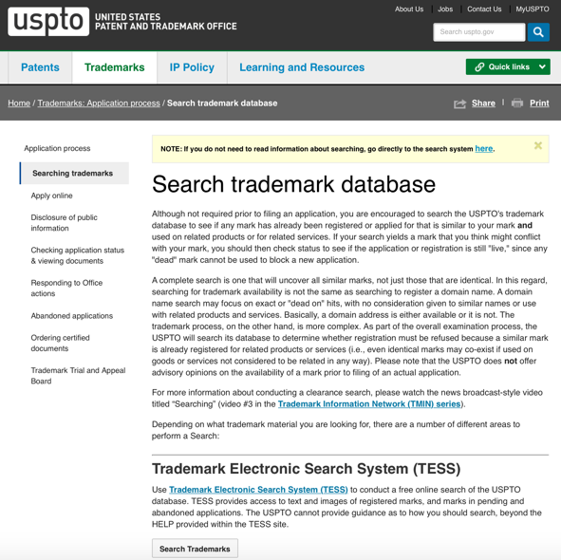
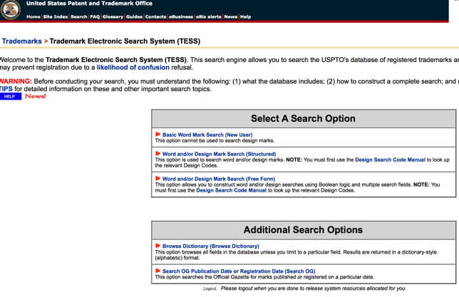

Slide 38
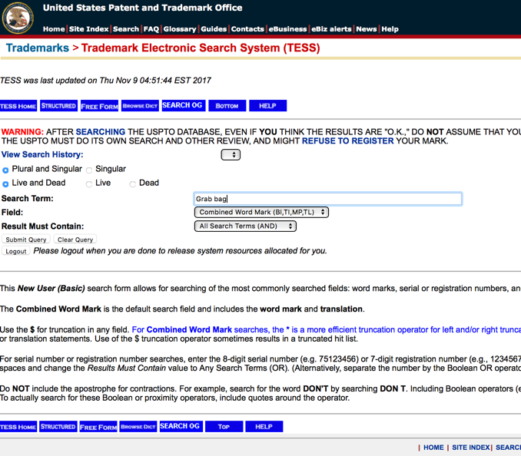
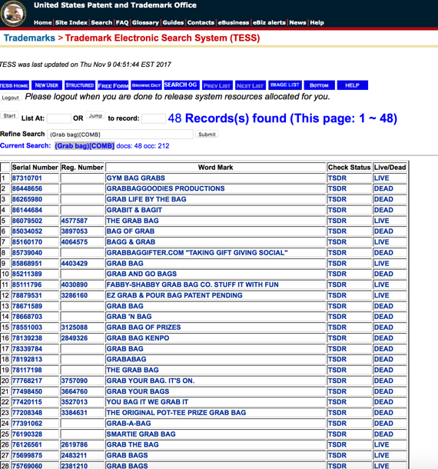

Slide 39


Consistent Voice

Slide 40
Your LOGO is not your brand. And it’s not a portrait in miniature of your business.
So don’t expect it to communicate much, if anything, about what you do.
Those disclaimers aside, a logo can be the anchor of a firm’s visual identity and a critical component of a successful brand.
As part of an overall brand approach, firm logos serve three primary functions:
Logo
Identification
Differentiation
Aiding recall

Slide 41
Logo Anatomy
Most firm logos can be broken into two parts: the name and the mark (sometime called its symbol or icon). The name is obvious enough: it’s the company or product name rendered in type. Skillful logo designers will spend a great deal of time choosing a typeface, often customizing its letter forms to make the name more personalized and proprietary.
The mark, usually separated slightly from the name, supports the brand name and offers a visual dimension to the brand identity experience. Some marks have become so well known that they’ve practically replaced the brand name itself (think Nike’s swoosh and Apple’s apple).

Slide 42
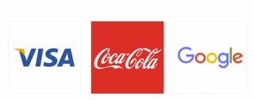

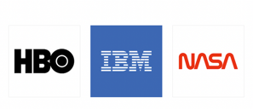

Logos can be sorted into a few basic categories. The five categories below will give you a way to think about your current logo and what you might want your new logo to be.
1. Logotypes A company name rendered in distinctive typography is the primary graphic element in these logos. Successful logotypes are bold and easy to read. Accenture, Deloitte and Exxon are good examples.
2. Monograms A monogram is a mark made up of a company’s initials (think IBM, McDonalds, and GE).

Slide 43




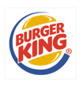



3. Abstract Marks Nonrepresentational marks that accompany a business’s name. (Sometimes, however, these marks can reflect a company’s name or other non-service-related attribute: Apple, Cisco, Dewberry.) Examples of abstract marks include Chase, BP, PWC, and Symantec.
4. Descriptive Marks Iconic representations of a company’s products, services or defining character. Because these marks can be limiting and generic looking, they are becoming rare in the corporate world. The National Cotton Council of America logo is a well-executed example.
5. Seals Type and an icon are contained inside a shape, usually a circle, oval, shield, or rectangle. Because of their limited legibility and dated appearance, seals are becoming less common. Many state and federal agencies still use seals, but they are rare in the business world.

Slide 44
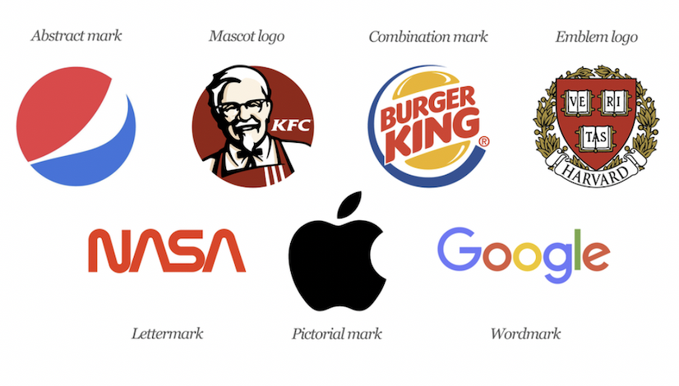

Slide 45
A good logo is distinctive, appropriate, practical, graphic and simple in form, and it conveys the owner’s intended message.
A concept or “meaning” is usually behind an effective logo, and it communicates the intended message.
A logo should be able to be printed at any size and, in most cases, be effective without color. A great logo essentially boils down to two things: great concept and great execution.

Slide 46
Best path forward.

Slide 47




Slide 48




Slide 49
Marketing – bundle of intangible benefits a company is providing to its customers, reflect the company’s core values

Slide 50

The Promotion Mix
Also, called its marketing communications mix consists of a specific blend of:
  Advertising –
    broadcast, print, online, mobile, outdoor, other
  Sales promotion –
    discounts, coupons, displays, demonstrations, events
  Personal selling –
  sales presentations, trade shows, and incentive programs
  Public relations –
      press releases, sponsorships, events, webpages
  Direct and digital marketing –
      direct mail, email, catalogs, online, social media, mobile marketing

Slide 51
Messaging tactics

Slide 52


Marketing plan

Slide 53
Questions

