Slide 1
Market Research
October 2021

Slide 2
What we will learn
Primary Research
Market Analysis

Slide 3
K.I.S.S.
Primary Research
Secondary Research

Slide 4
Primary Research & Interviewing
LinkedIn

Slide 5
Market Analysis
Potential Size of the Market(s) & Timing
Characteristics About Consumers in Target Market(s)
Share and Brand Identity of Existing Competitors

Slide 6
Market Research Databases @ FSU
NetAdvantage
IBISWorld Industry Market Research
Mintel Academic
Gartner Higher Education
BCC Market Research
eMarketer Pro
WGSN
SMA: Sport Market Analytics
RKMA eBooks
University Internet Reporter

Slide 7
Who knows
Who would know the answer to this question?
Where would I be most likely to find that statistic?
Who regulates or what laws govern the area you are looking for?
Google is your friend!
Ask someone!

Slide 8
Demographics
Statista
Demographics Now
American Factfinder

Slide 9
Government Data
Data.gov
Federal Reserve Beige Book
Florida Legislature - Office of Economic and Demographic Research
Tallahassee Data
FSU Office of Institutional Research

Slide 10
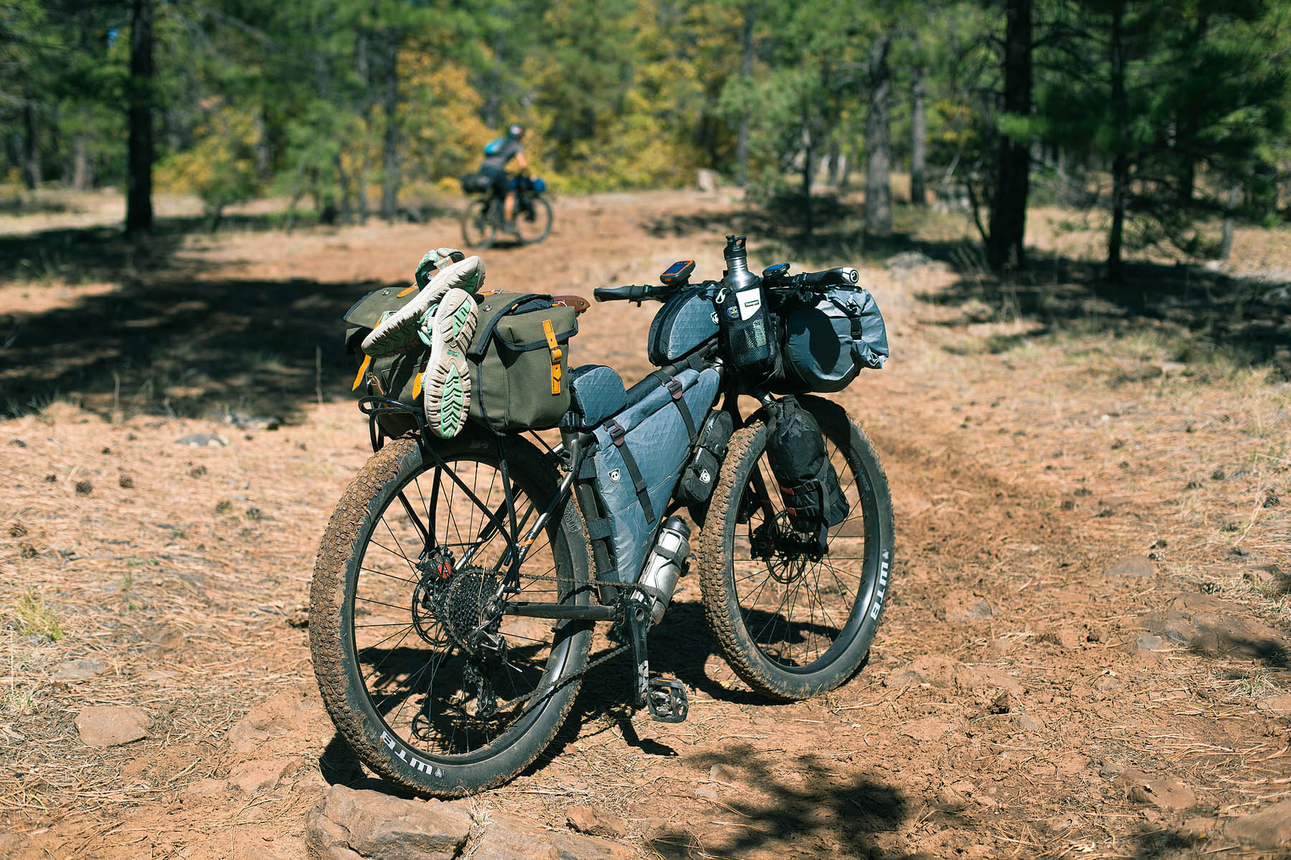
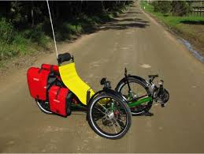
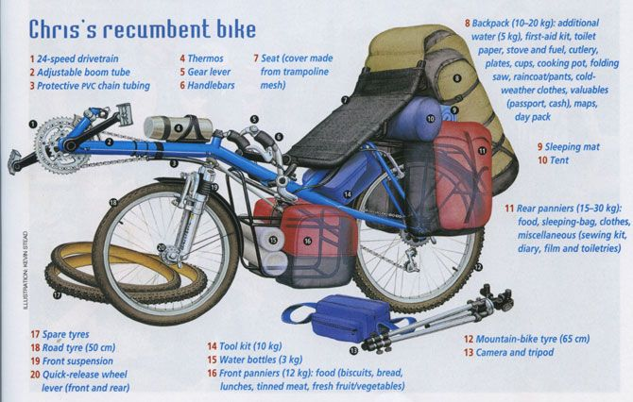
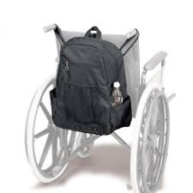
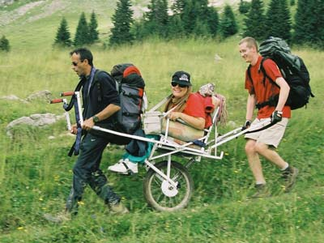
Path of Research
https://thebikeshoplist.com/
https://www.christopherreeve.org/living-with-paralysis/stats-about-paralysis

