Slide 1
Revenue Streams &
Cost Structure
Notes:
Introduction to
Growth
CRI Leadership Academy 2014
May 5, 2014
Orlando, Florida
Facilitated by Phyllis Ingram, Alan Jowers, Brent Sparkman and David Turpin

Slide 2
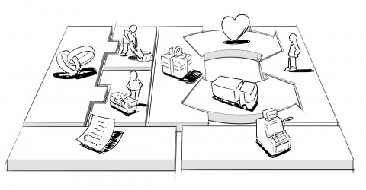
Revenue Streams
Revenue Streams
Notes:
Notes:
___________________________________________________________
___________________________________________________________
___________________________________________________________
___________________________________________________________
___________________________________________________________
___________________________________________________________
___________________________________________________________

Slide 3
Revenue Streams
How do you generate cash from each customer segment?
What value do customers put on the benefits you provide?
What value are customers willing to pay for?
What value do customers infer from your pricing?
Revenue streams = what
Pricing = how much and when
Notes:
Notes:
___________________________________________________________
___________________________________________________________
___________________________________________________________
___________________________________________________________
___________________________________________________________
___________________________________________________________
___________________________________________________________

Slide 4
Revenue Streams
Price on VALUE – not based on cost
(but know your cost)
Two different types:
Transaction revenues (one-time payments)
Recurring revenues (ongoing payments or cust. support)
Every customer segment needs a revenue model
(free is ok, but know it)
This concept is not about an IS, BS, or CF. Those are operating
details that are derived from a proven revenue model and pricing.
Notes:
Notes:
___________________________________________________________
___________________________________________________________
___________________________________________________________
___________________________________________________________
___________________________________________________________
___________________________________________________________
___________________________________________________________

Slide 5
Revenue Streams
Ways to generate revenue:
Sale of physical assets (Amazon, automobiles)
Usage fees (pay by minute phones, hotels)
Subscription (gym)
Renting/leasing (Zipcar)
Licensing (media industry, IP)
Brokerage fees (RE, consultants, finance)
Advertising (software, media)
Perhaps a combination of one or more?
Notes:
Notes:
___________________________________________________________
___________________________________________________________
___________________________________________________________
___________________________________________________________
___________________________________________________________
___________________________________________________________
___________________________________________________________

Slide 6
Revenue Streams
Revenue stream is the strategy used to generate cash
from customers
Pricing is a tactic
What kind of pricing model will you have?
Which do you prefer?
Notes:
Notes:
___________________________________________________________
___________________________________________________________
___________________________________________________________
___________________________________________________________
___________________________________________________________
___________________________________________________________
___________________________________________________________

Slide 7
Cost Structure
Cost Structure

Slide 8
Cost Structure
What are the critical elements of the cost structure?
Fixed costs
Variable costs
Resource, activity, partner costs
Infrastructure, operational, cost of sales
Payroll costs, benefits, bonus structure, taxes
What are the costs of each element of the business model?
Where are the economies of scale?
What are the risks, the unknowns?

Slide 9
Cost Structure
All stages incur costs – creating and delivering value, customer relations, and generating revenue.
What are some strategies for decreasing front-end fixed costs? What are the pros & cons of each?
What options do you have if you cannot BE soon enough?

Slide 10
Testing your hypothesis
What are customers willing to pay?
How will they pay?
What kind of revenue are you generating? Transactional or recurring?
Sample, test potential customers & vendors
Online and off
Solicit feedback

Slide 11
Testing your hypothesis
Hypothesis: Here’s what we thought
Experiments: Here’s what we did
Results: Here’s what we found
Action: Here’s what we’re going to do next

Slide 12
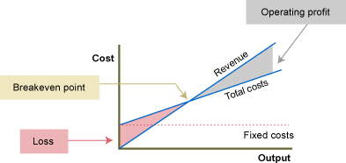
Break even point
Create a rough 3 year income statement to show you have a real business with your revenue model(s), channels, costs, etc.
What is your break even point?

Slide 13
Break even point

Slide 14
What to include?
Pro forma financials - your best estimate of your future results
Revenue, and growth %
Cost of sales, GP, %
Expenses, EBITDA, %

