Slide 4
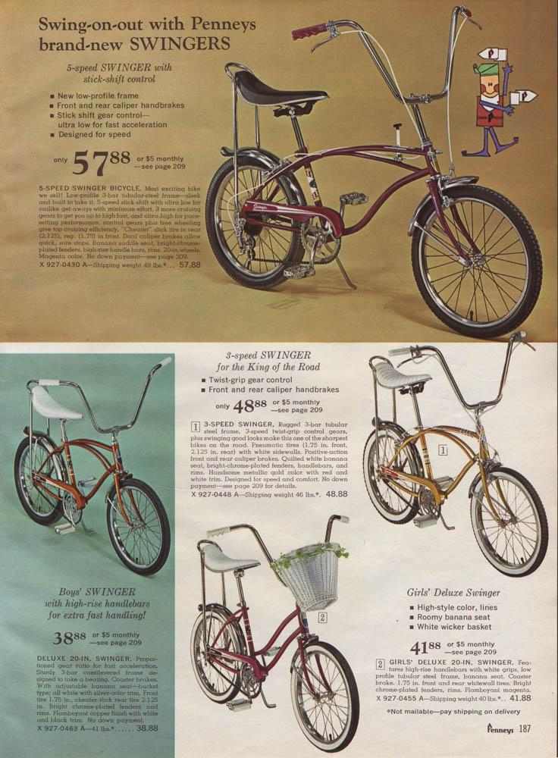
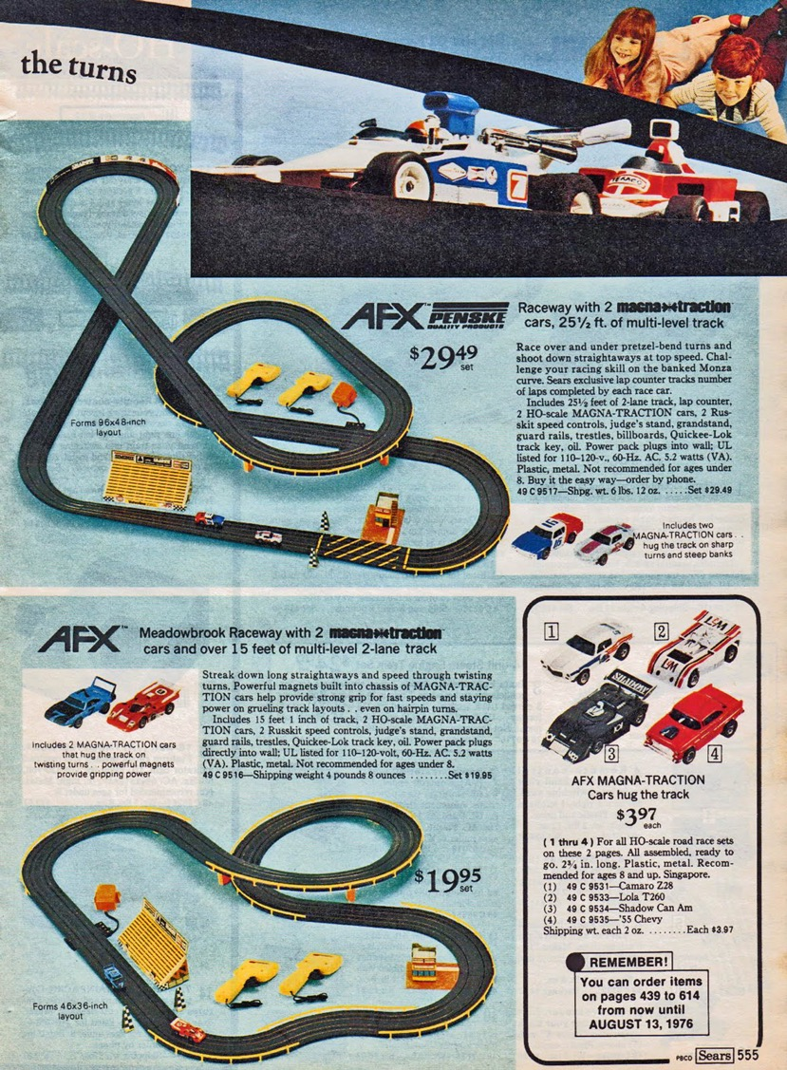
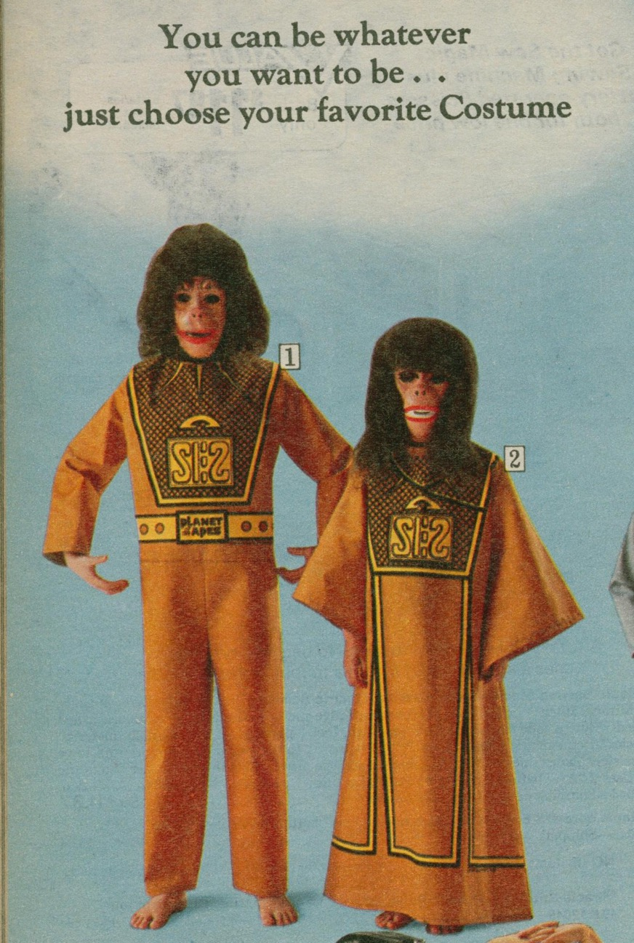
@markmcnees
markmcnees.com
mark@redeyecoffee.org

Slide 5
@markmcnees
markmcnees.com
mmcnees@fsu.edu

Slide 6
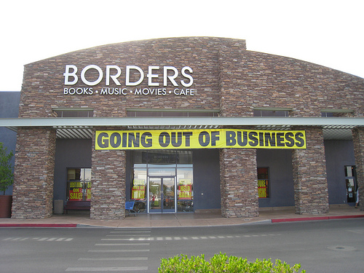
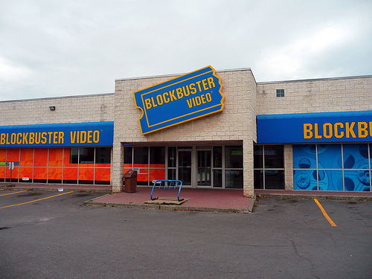
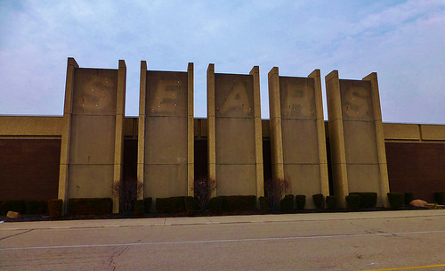
@markmcnees
markmcnees.com
mmcnees@fsu.edu

Slide 7
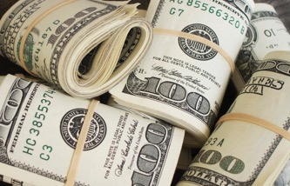

Slide 9
So what happened?
@markmcnees
markmcnees.com
mmcnees@fsu.edu

Slide 10
Every revolution has winners and losers...
@markmcnees
markmcnees.com
mmcnees@fsu.edu

Slide 11
…those who are willing to evolve, historically are the winners.
@markmcnees
markmcnees.com
mmcnees@fsu.edu

Slide 12
The Tale of Netflix and Blockbuster

Slide 13
Notes:
When Netflix launched in 1997, Blockbuster was the undisputed champion of the video rental industry. Between 1985 and 1992, the brick-and-mortar rental chain grew from its first location (in Dallas, Texas) to more than 2,800 locations around the world.
So by the time Netflix showed up on the scene with its video rental-by-mail service, it appeared to be a classic case of David vs. Goliath.
In fact, in the year 2000 –perhaps realizing that it’d be easier to fight alongside Blockbuster than against them – Netflix co-founder and CEO Reed Hastings approached Blockbuster’s then CEO, John Antioco, with a merger proposal:
Hastings wanted $50 million for Netflix. And as part of the deal, the Netflix team would run Blockbuster’s online brand.
Of course, that deal never materialized. Partly because Blockbuster laughed in Netflix’s face when they met to discuss the deal.
https://www.drift.com/blog/netflix-vs-blockbuster/

Slide 14
Perfecting the Past

Slide 15
Innovate today to compete tomorrow.

Slide 16
Four Economic Revolutions
@markmcnees
markmcnees.com
mmcnees@fsu.edu

Slide 17
Economic Revolutions
Agricultural Revolution
10,000 BC
@markmcnees
markmcnees.com
mmcnees@fsu.edu

Slide 18
Economic Revolutions
Agricultural Revolution
Industrial Revolution
10,000 BC
18th-19th
@markmcnees
markmcnees.com
mmcnees@fsu.edu

Slide 19
Economic Revolutions
Agricultural Revolution
Industrial Revolution
Technology Revolution
10,000 BC
18th-19th
Mid-20th
@markmcnees
markmcnees.com
mmcnees@fsu.edu

Slide 20
Economic Revolutions
Agricultural Revolution
Industrial Revolution
Technology Revolution
Responsibility Revolution
10,000 BC
18th-19th
Mid-20th
NOW
@markmcnees
markmcnees.com
mmcnees@fsu.edu
https://www.forbes.com/sites/economaney/2013/03/01/the-biggest-story-of-our-lives-economic-revolution/#5f90e09c4e6d

Slide 21
Maslow’s Hierarchy of Needs

Slide 22
@markmcnees
markmcnees.com
mmcnees@fsu.edu

Slide 23
Basic Needs
@markmcnees
markmcnees.com
mmcnees@fsu.edu

Slide 24
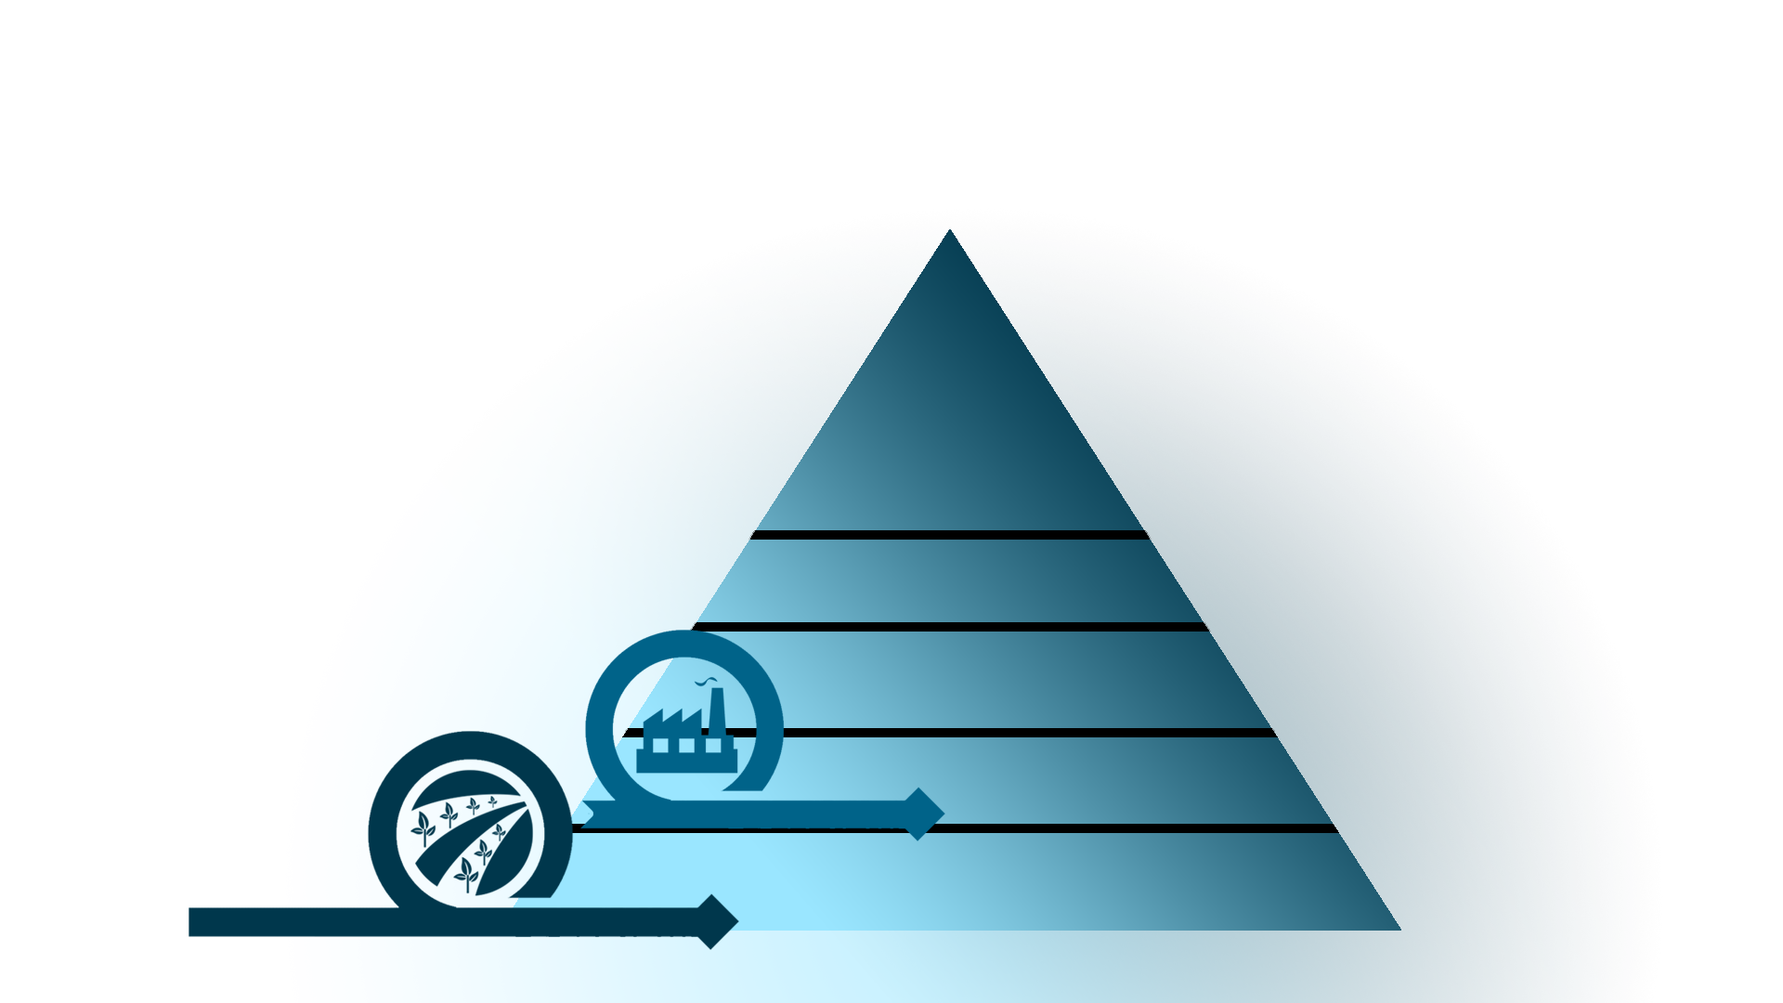
Basic & Psychological Needs
Basic Needs
@markmcnees
markmcnees.com
mmcnees@fsu.edu

Slide 25
Psychological Needs
Basic & Psychological Needs
Basic Needs
@markmcnees
markmcnees.com
mmcnees@fsu.edu

Slide 26
Psychological and Self-Fulfillment Needs
Psychological Needs
Basic & Psychological Needs
Basic Needs
@markmcnees
markmcnees.com
mmcnees@fsu.edu

Slide 27
What is a Social Enterprise?
A company that has a market solution to a social problem.
@markmcnees
markmcnees.com
mmcnees@fsu.edu

Slide 28
@markmcnees
markmcnees.com
mmcnees@fsu.edu

Slide 29
@markmcnees
markmcnees.com
mmcnees@fsu.edu

Slide 30
Corporate social responsibility refers to a private business who self-regulates its business practices in relation to people, planet, and profits, also known as a triple bottom line.
@markmcnees
markmcnees.com
mmcnees@fsu.edu

Slide 32
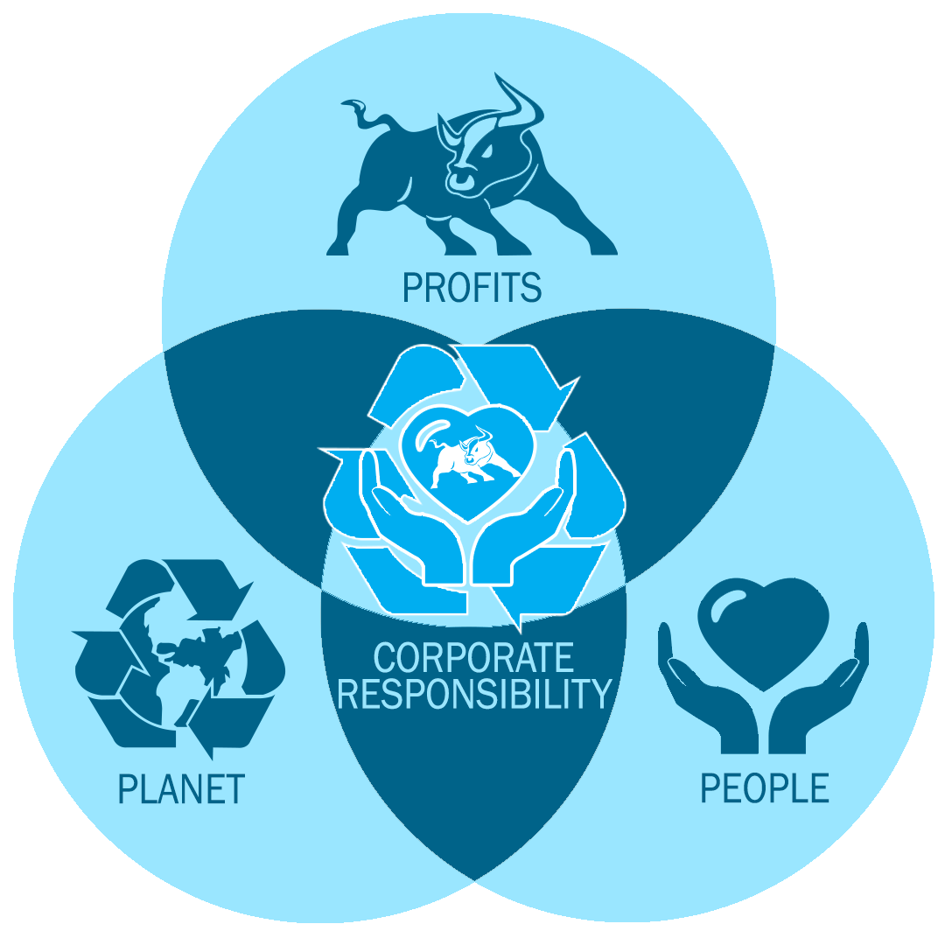
@markmcnees
markmcnees.com
mmcnees@fsu.edu

Slide 33
Examples of SICs
@markmcnees
markmcnees.com
mmcnees@fsu.edu

Slide 38
@markmcnees
markmcnees.com
mmcnees@fsu.edu

Slide 41
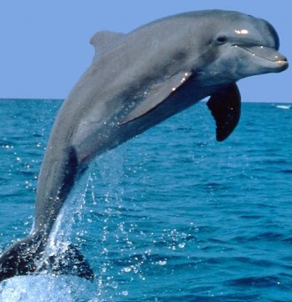
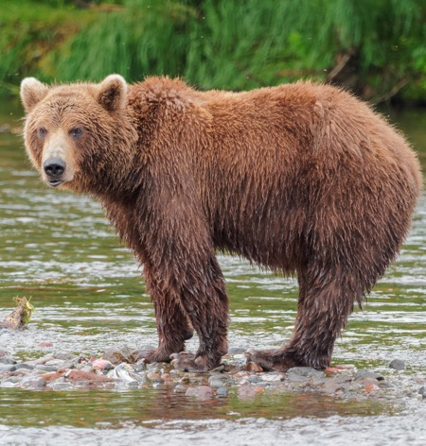
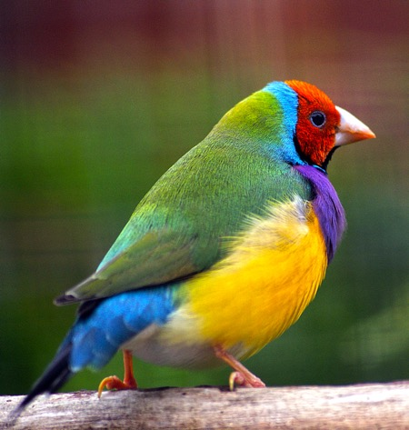
What is the difference?

Slide 42
How to start a
@markmcnees
markmcnees.com
mmcnees@fsu.edu

Slide 44
@markmcnees
markmcnees.com
mmcnees@fsu.edu

Slide 45
Developing a triple bottom line is the best way to grow your financial bottom line in the future…
@markmcnees
markmcnees.com
mmcnees@fsu.edu

Slide 46
…and if you are not evolving, I can guarantee you that there are entrepreneurs who are.
@markmcnees
markmcnees.com
mmcnees@fsu.edu

Slide 47
Deck available at markmcnees.com
mmcnees@fsu.edu
Mark McNees
YourEntrepreneurshipCoach.com
@markmcnees

